Slide 1
Tutorial Machine Learning in Solid Mechanics
Task 2&3: Hyperelasticity
Fabian Roth

Slide 2
Tutorial Machine Learning in Solid Mechanics
Sections
2.1
Data preparation
3.1
Invariant-based model
2.2
Naive model
3.2
Deformation-gradient based model
2.3
Physics-augmented model
3.3
Data augmentation
2.4
Concentric sampled deformation gradients

Slide 3
Task 2
Hyperelasticity I

Slide 4
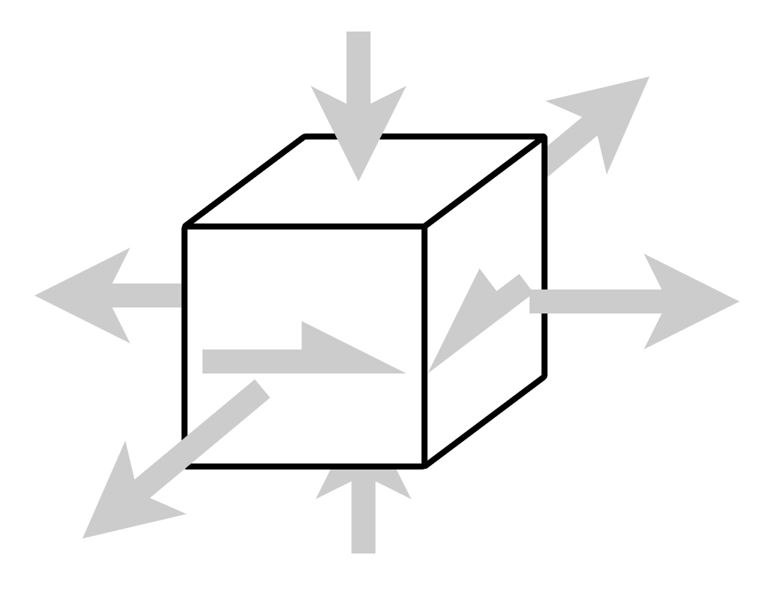
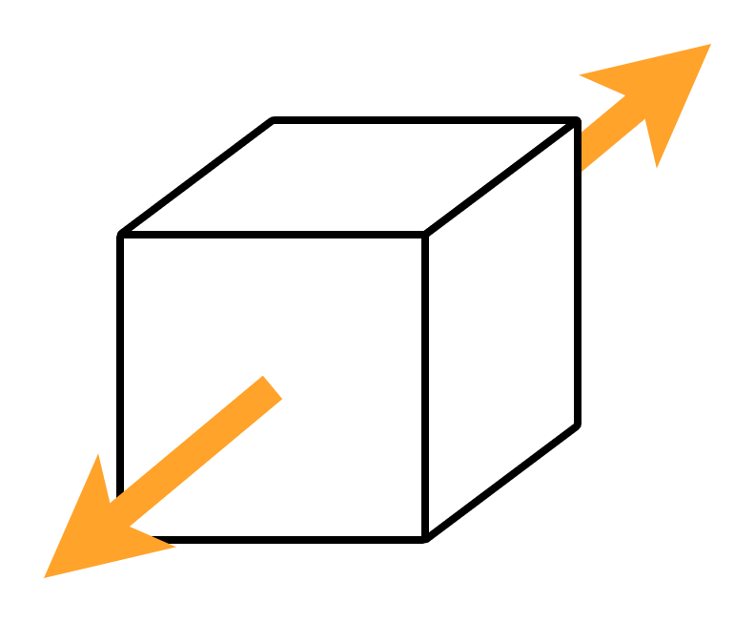
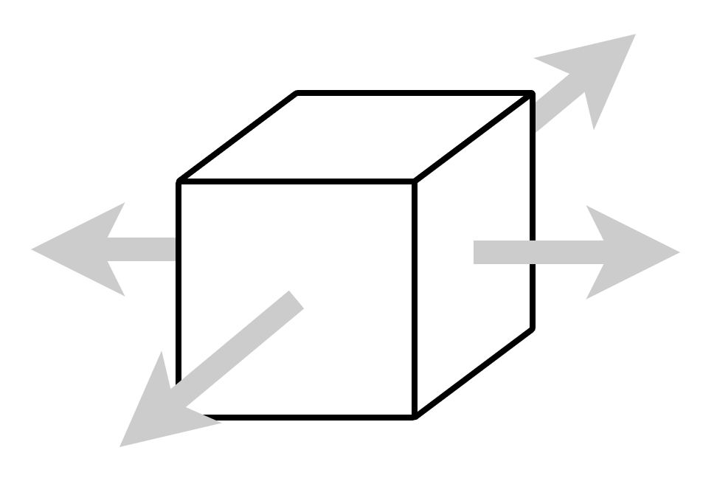
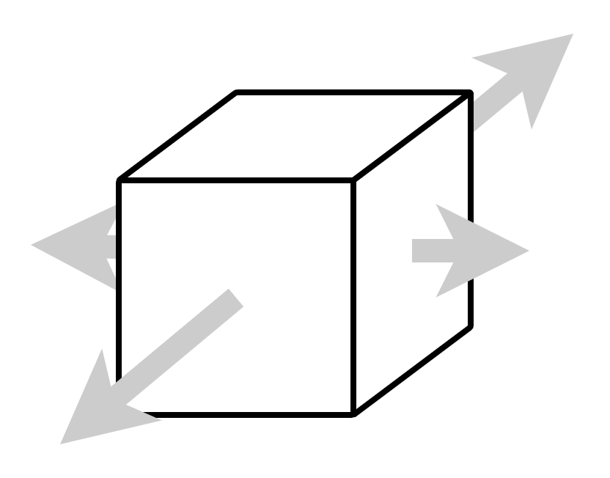
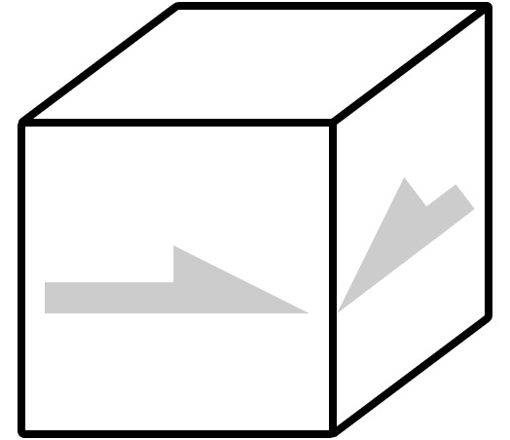
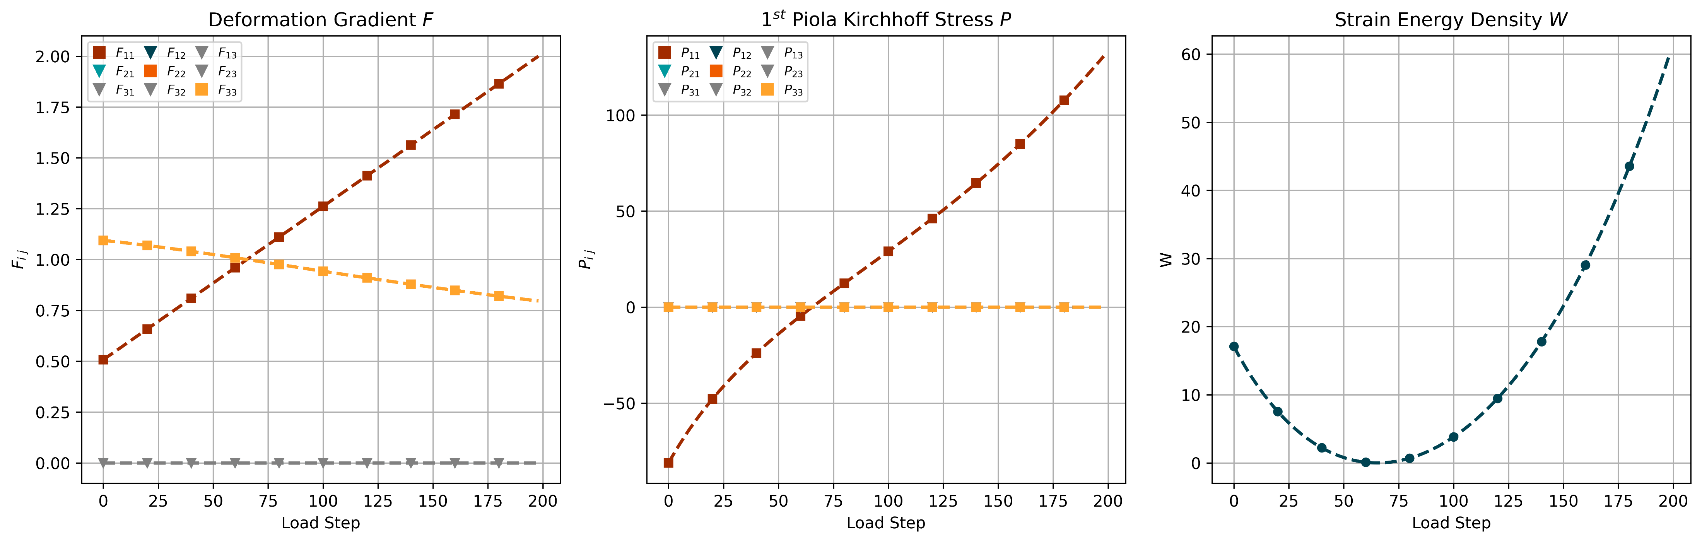
2 - 1.1
Data - Uniaxial

Slide 5
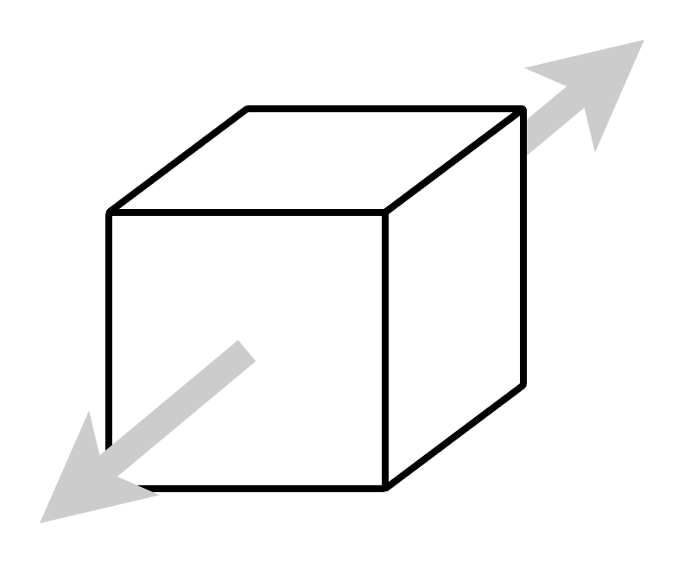
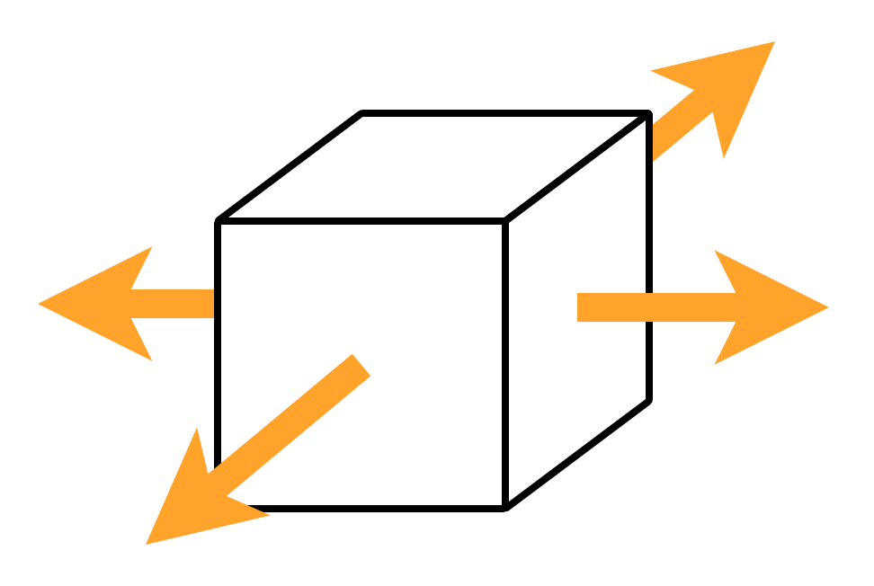
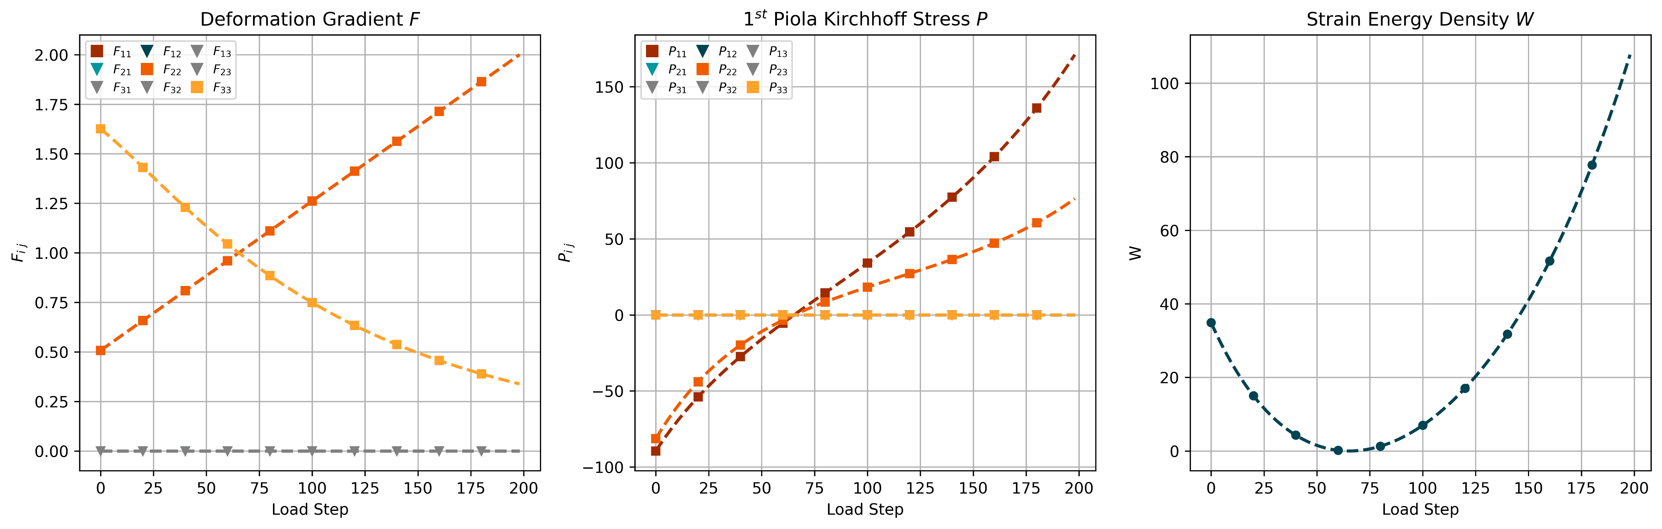
2 - 1.1
Data - Biaxial

Slide 6
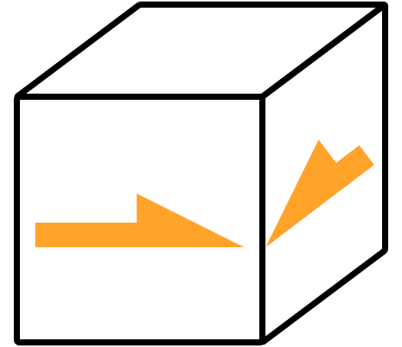
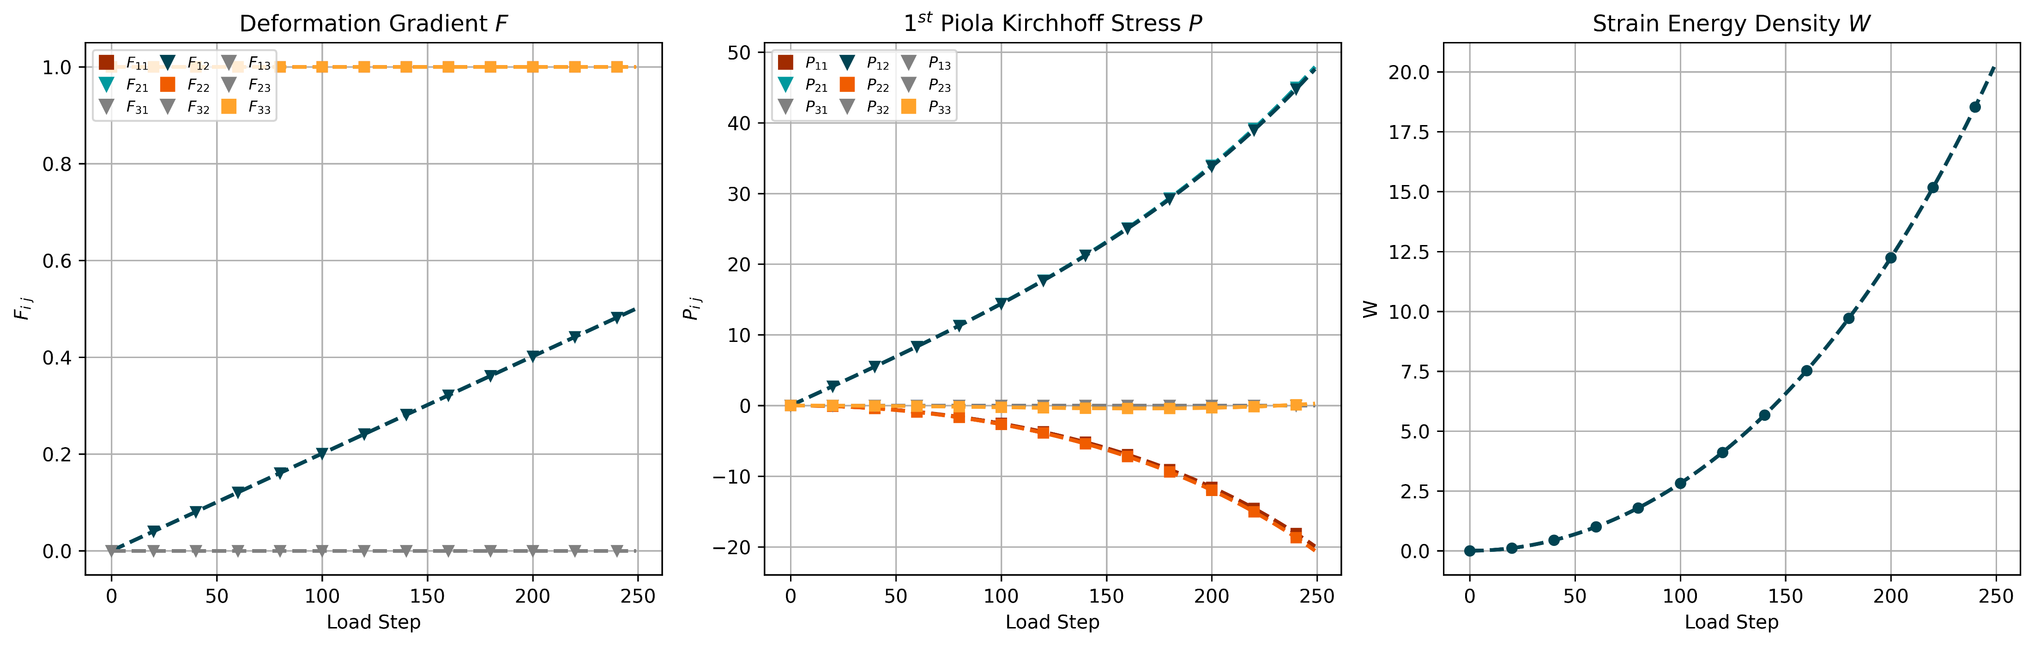
2 - 1.1
Data - Shear

Slide 7
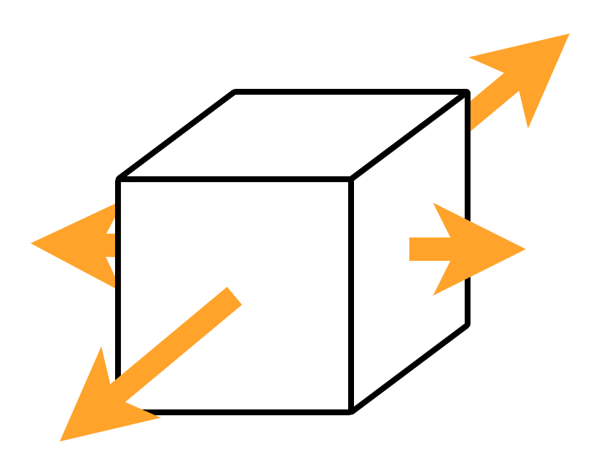
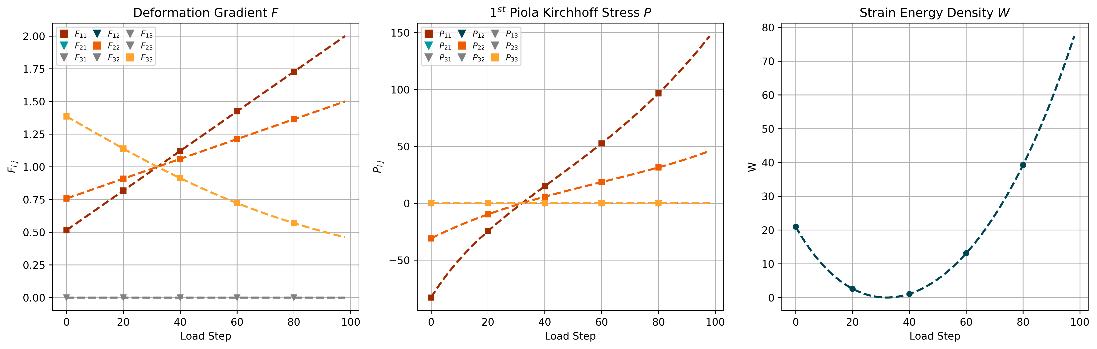
2 - 1.1
Data - Biaxial Test

Slide 8
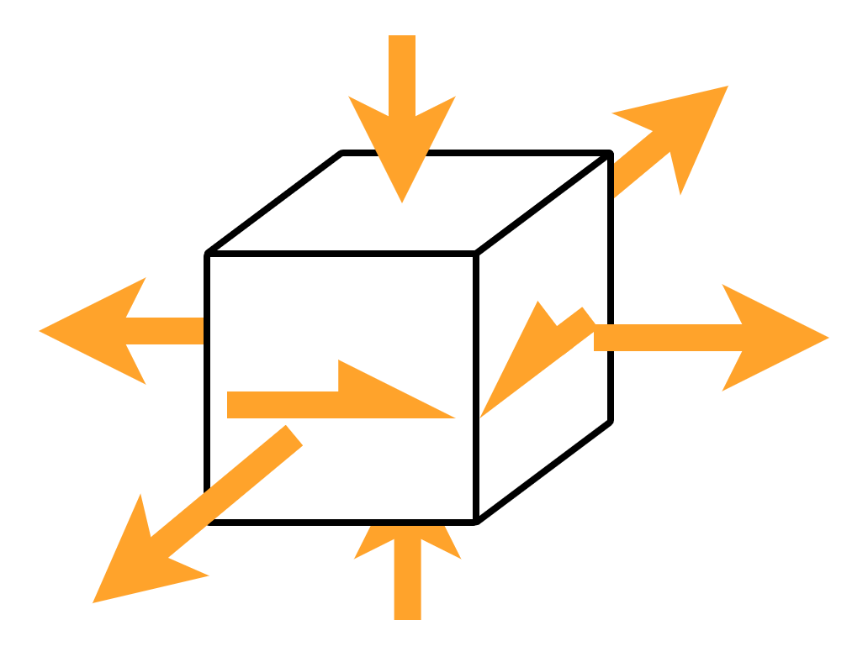
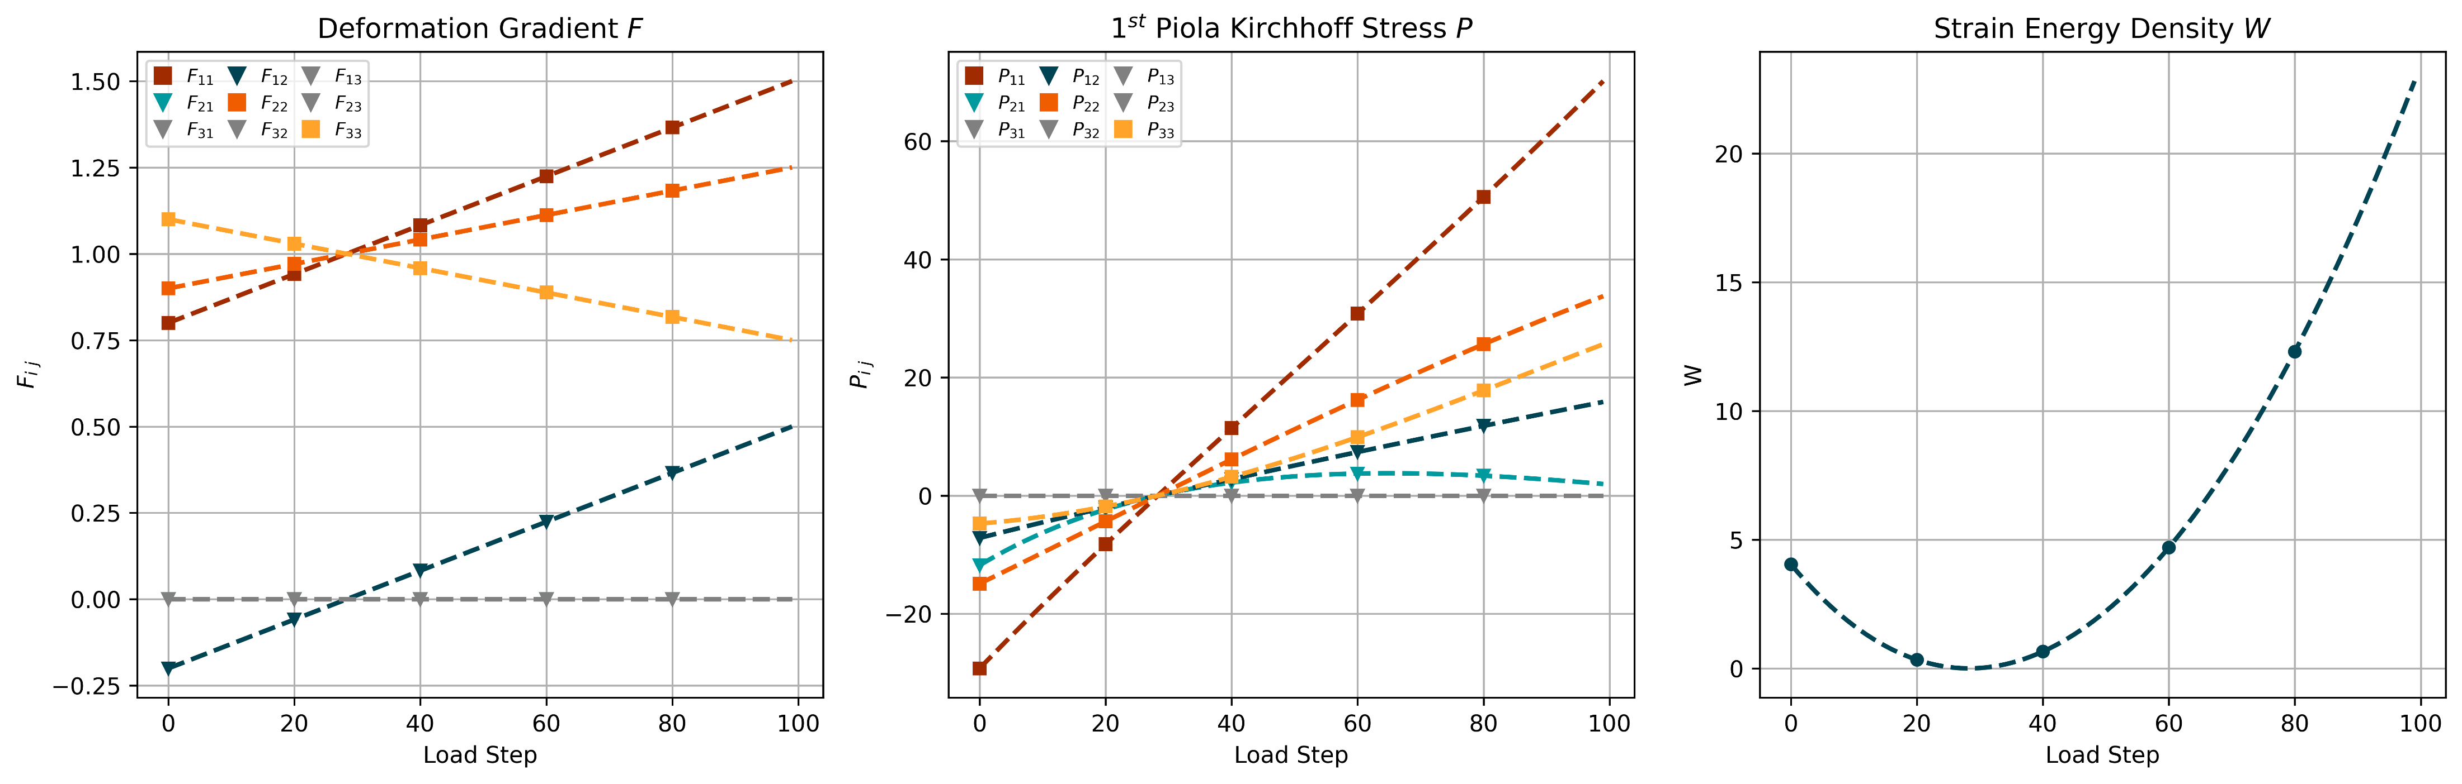
2 - 1.1
Data - Mixed Test
Notes:
Talk about interpolation/extrapolation

Slide 9
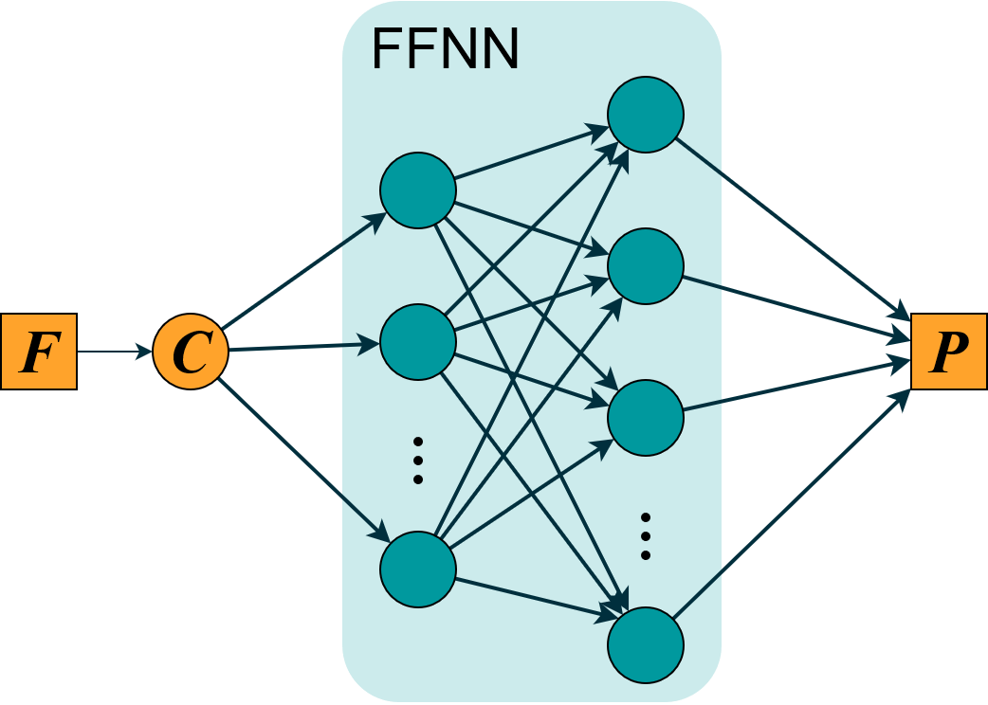
2 – 2.2
Naive Model
Physical conditions:

Slide 10

2 – 2.2
Naive Model
Physical conditions:
Objectivity

Slide 11

2 – 2.2
Naive Model
Physical conditions:
Objectivity
Material Symmetry
Thermodynamics
Polyconvexity/Ellipticity
Normalization
Growth Condition

Slide 12
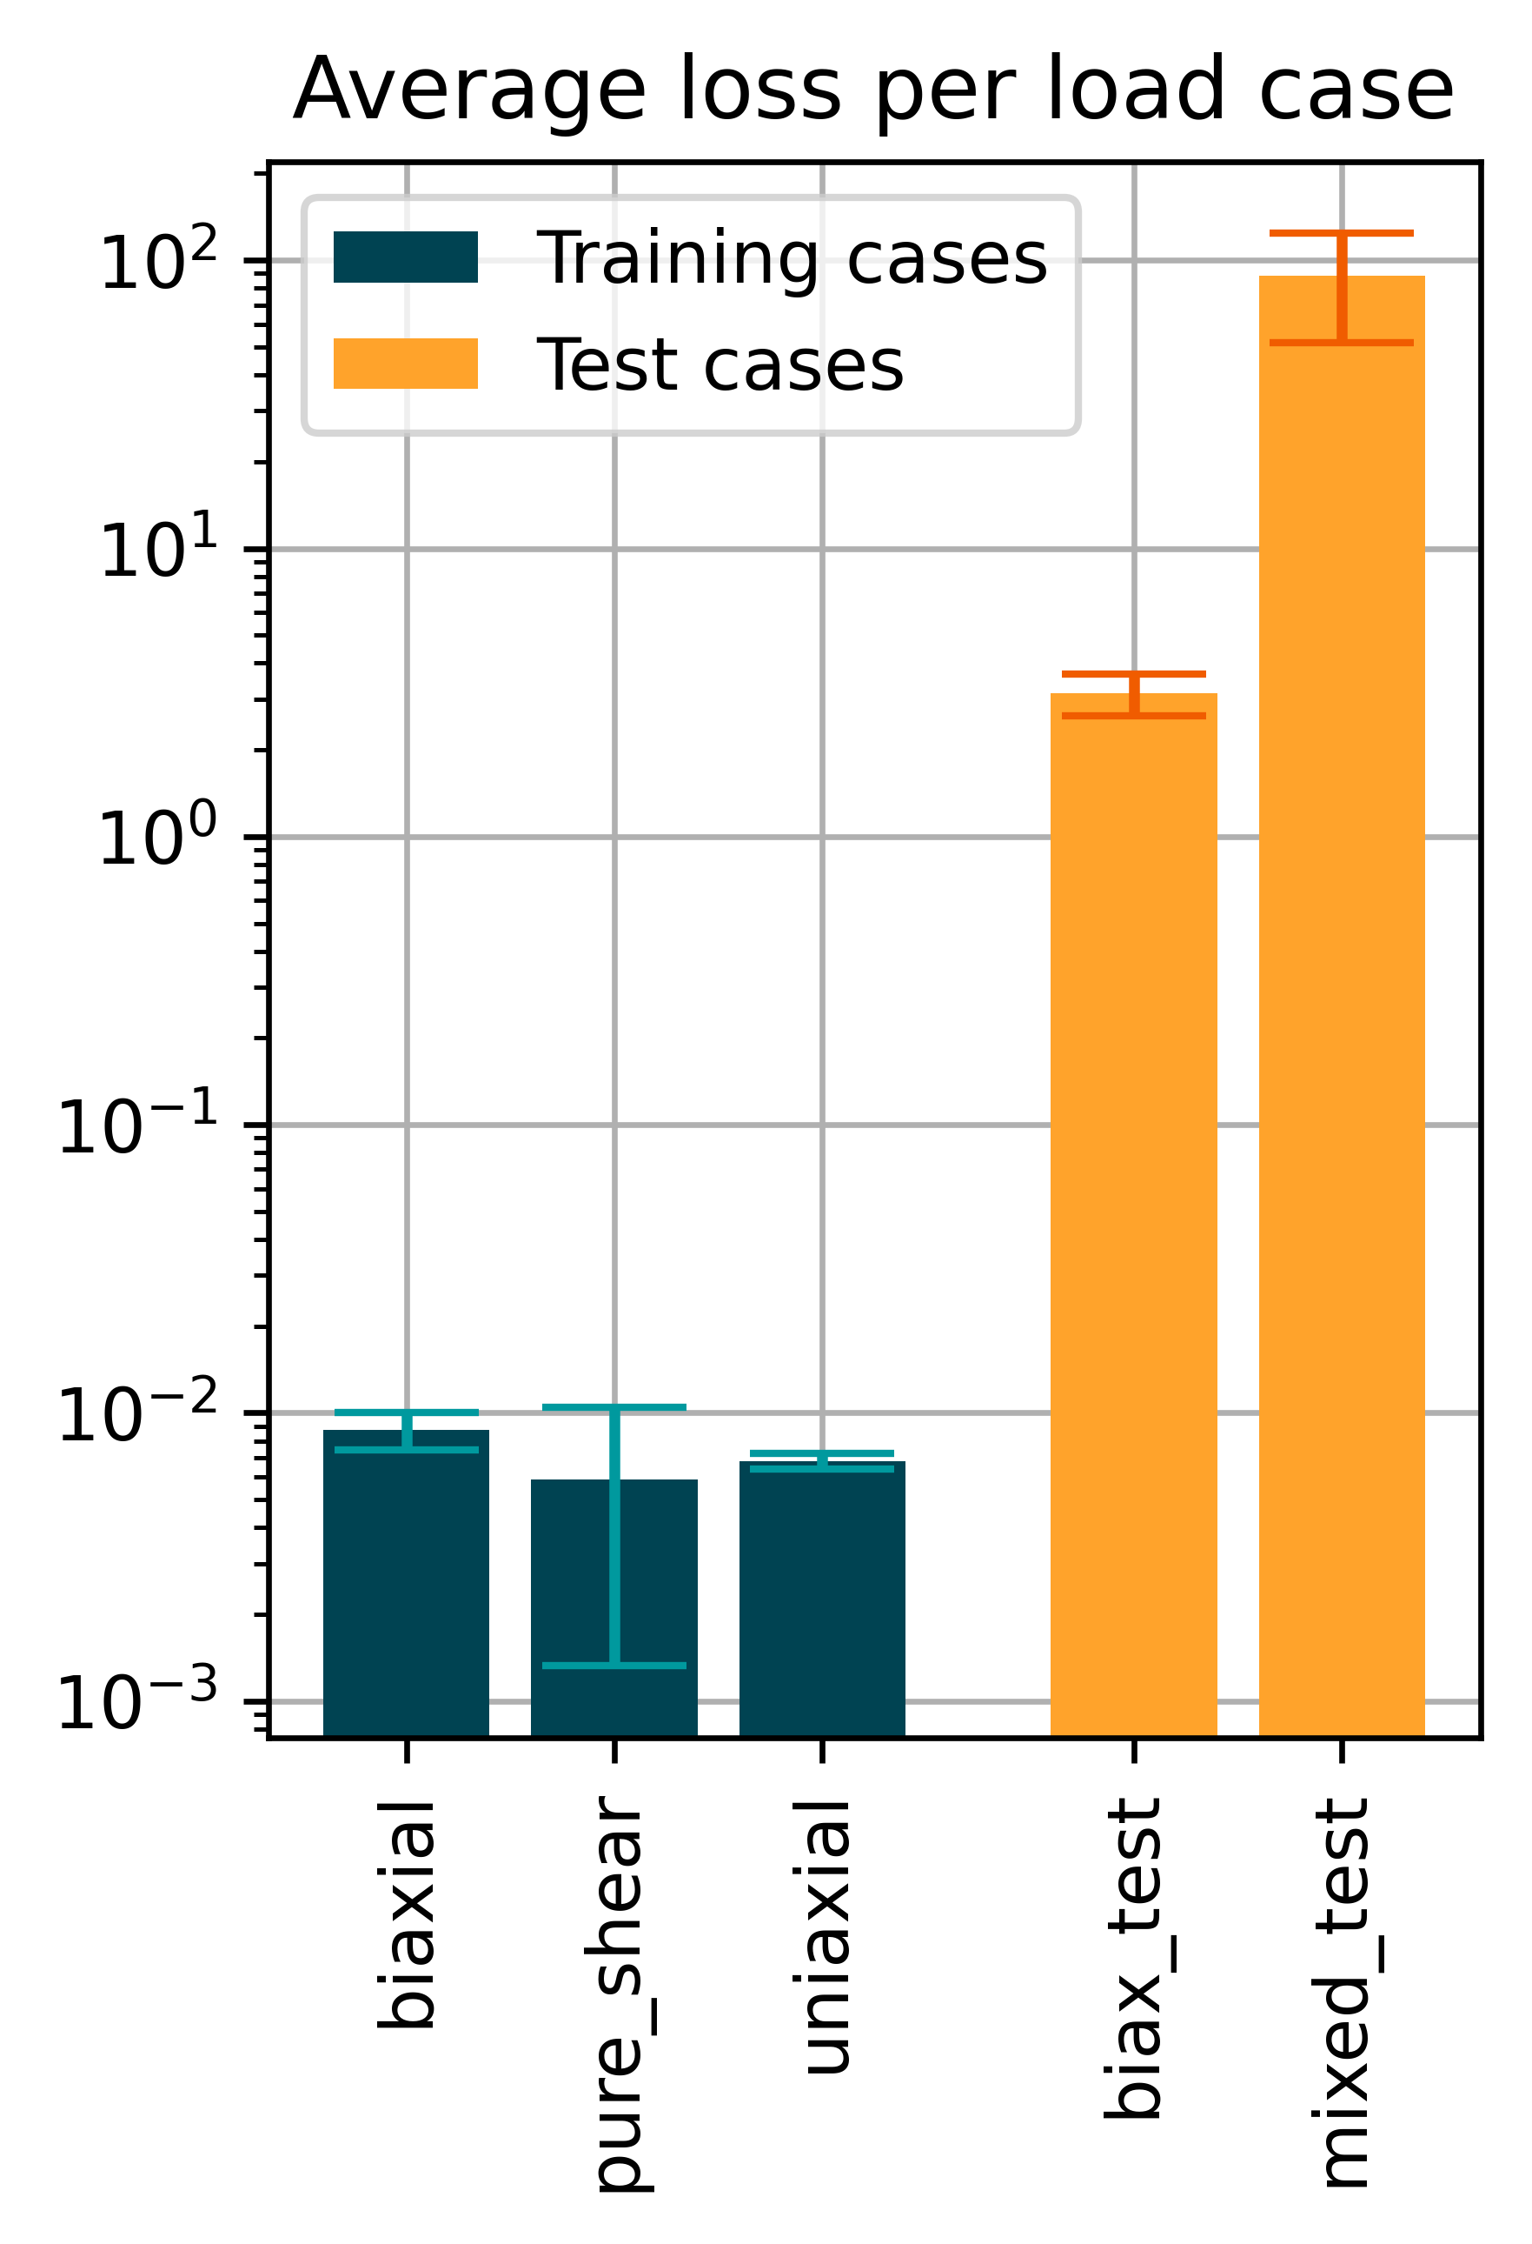
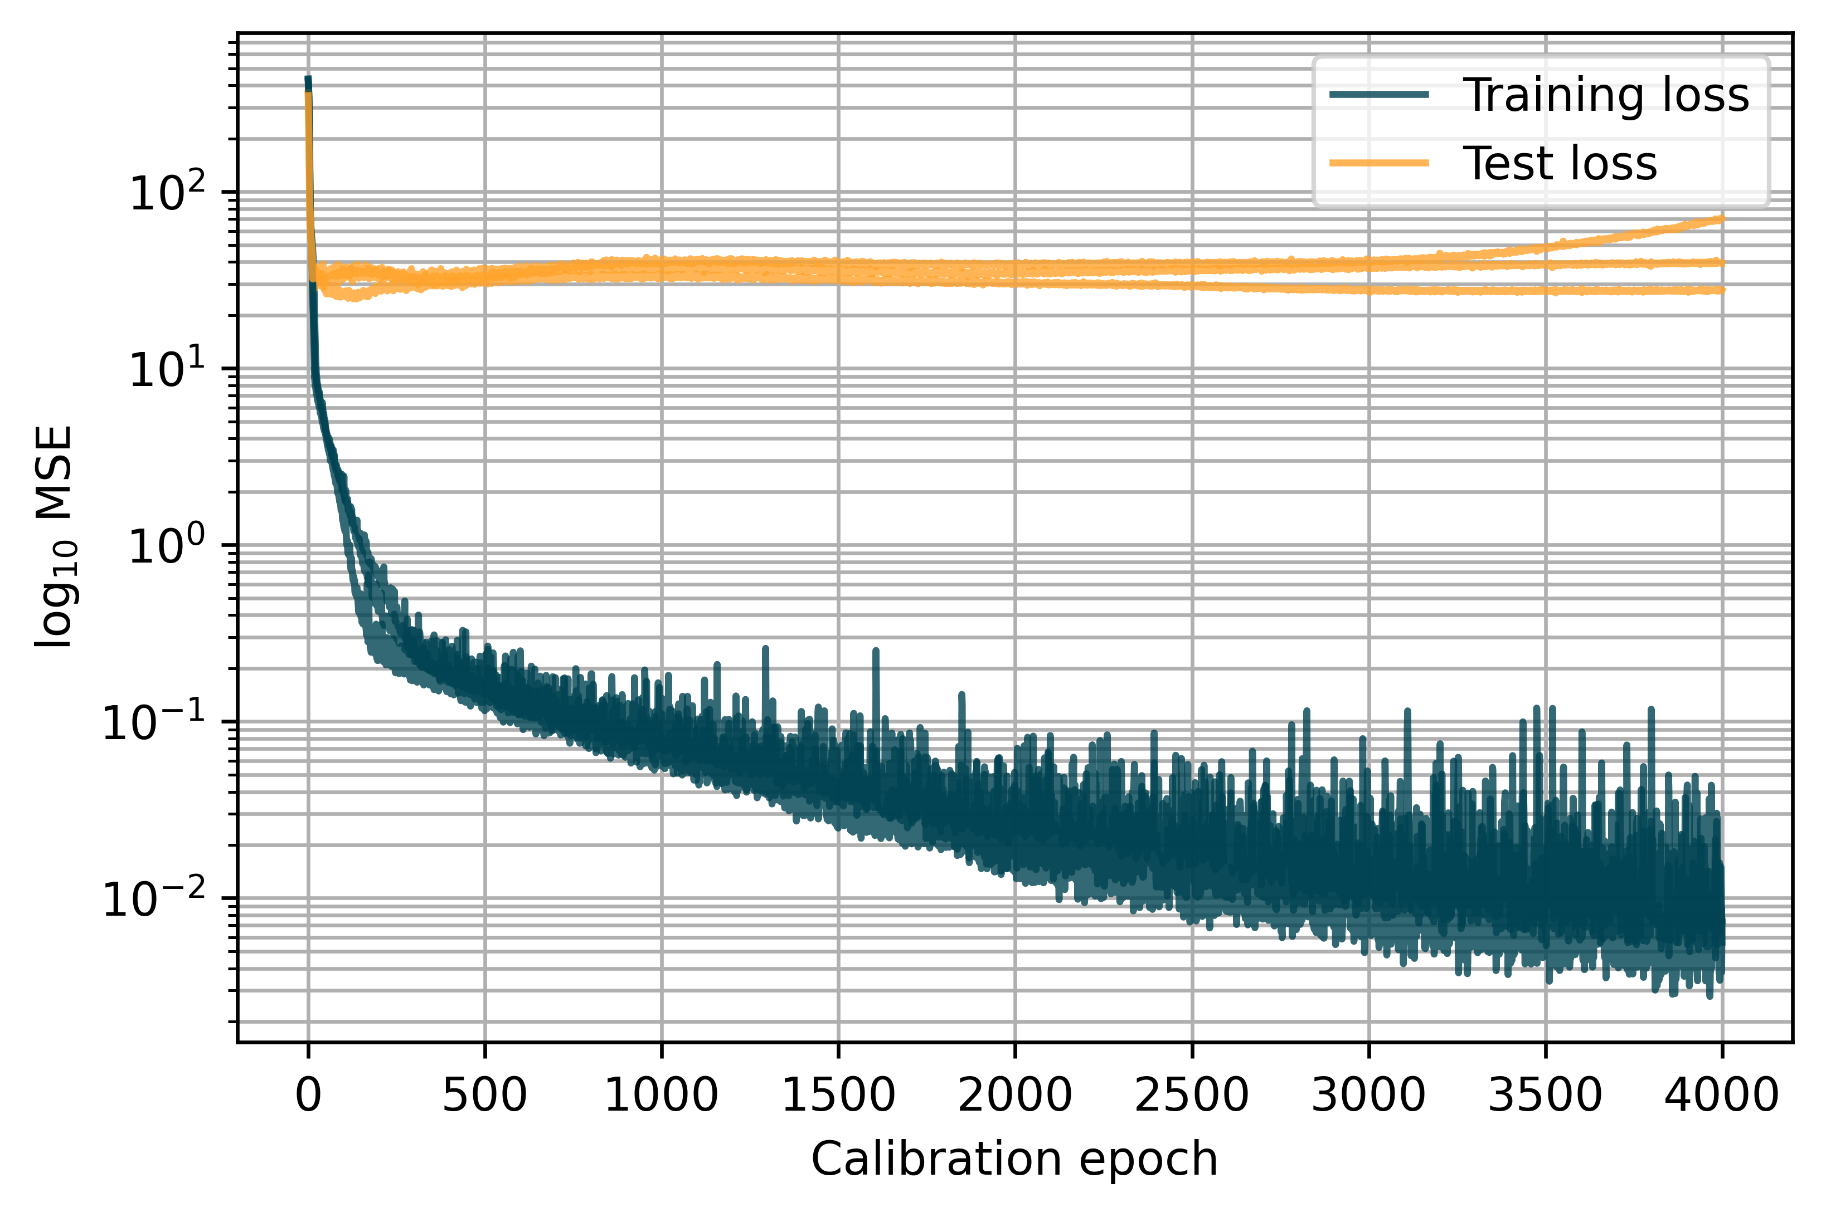
2 – 2.2
Naive Model
3 Instances
Layers: 16, 16, 9 Epochs: 4000 Learn rate: 0.005
Notes:
BAR GRAPH AXIS LABEL!!

Slide 13
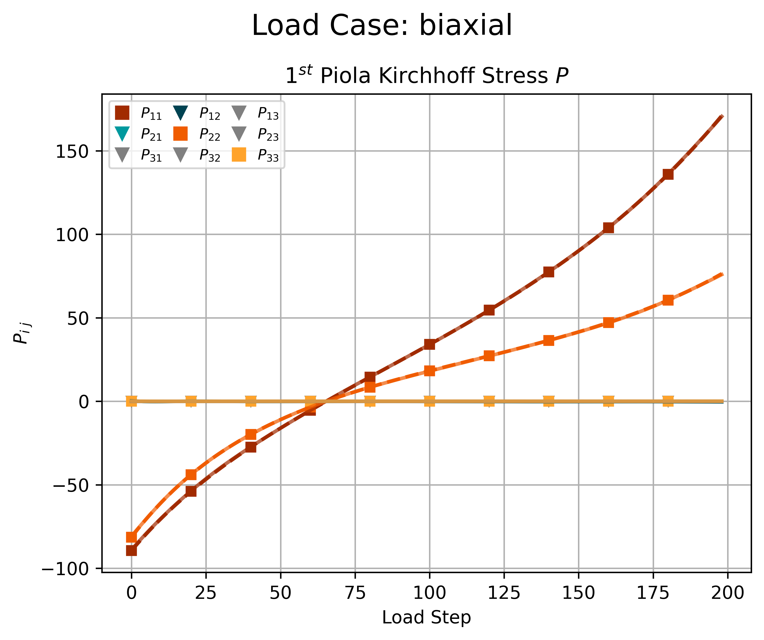

2 – 2.2
Naive Model - Biaxial
Notes:
Model learned normalization!

Slide 14
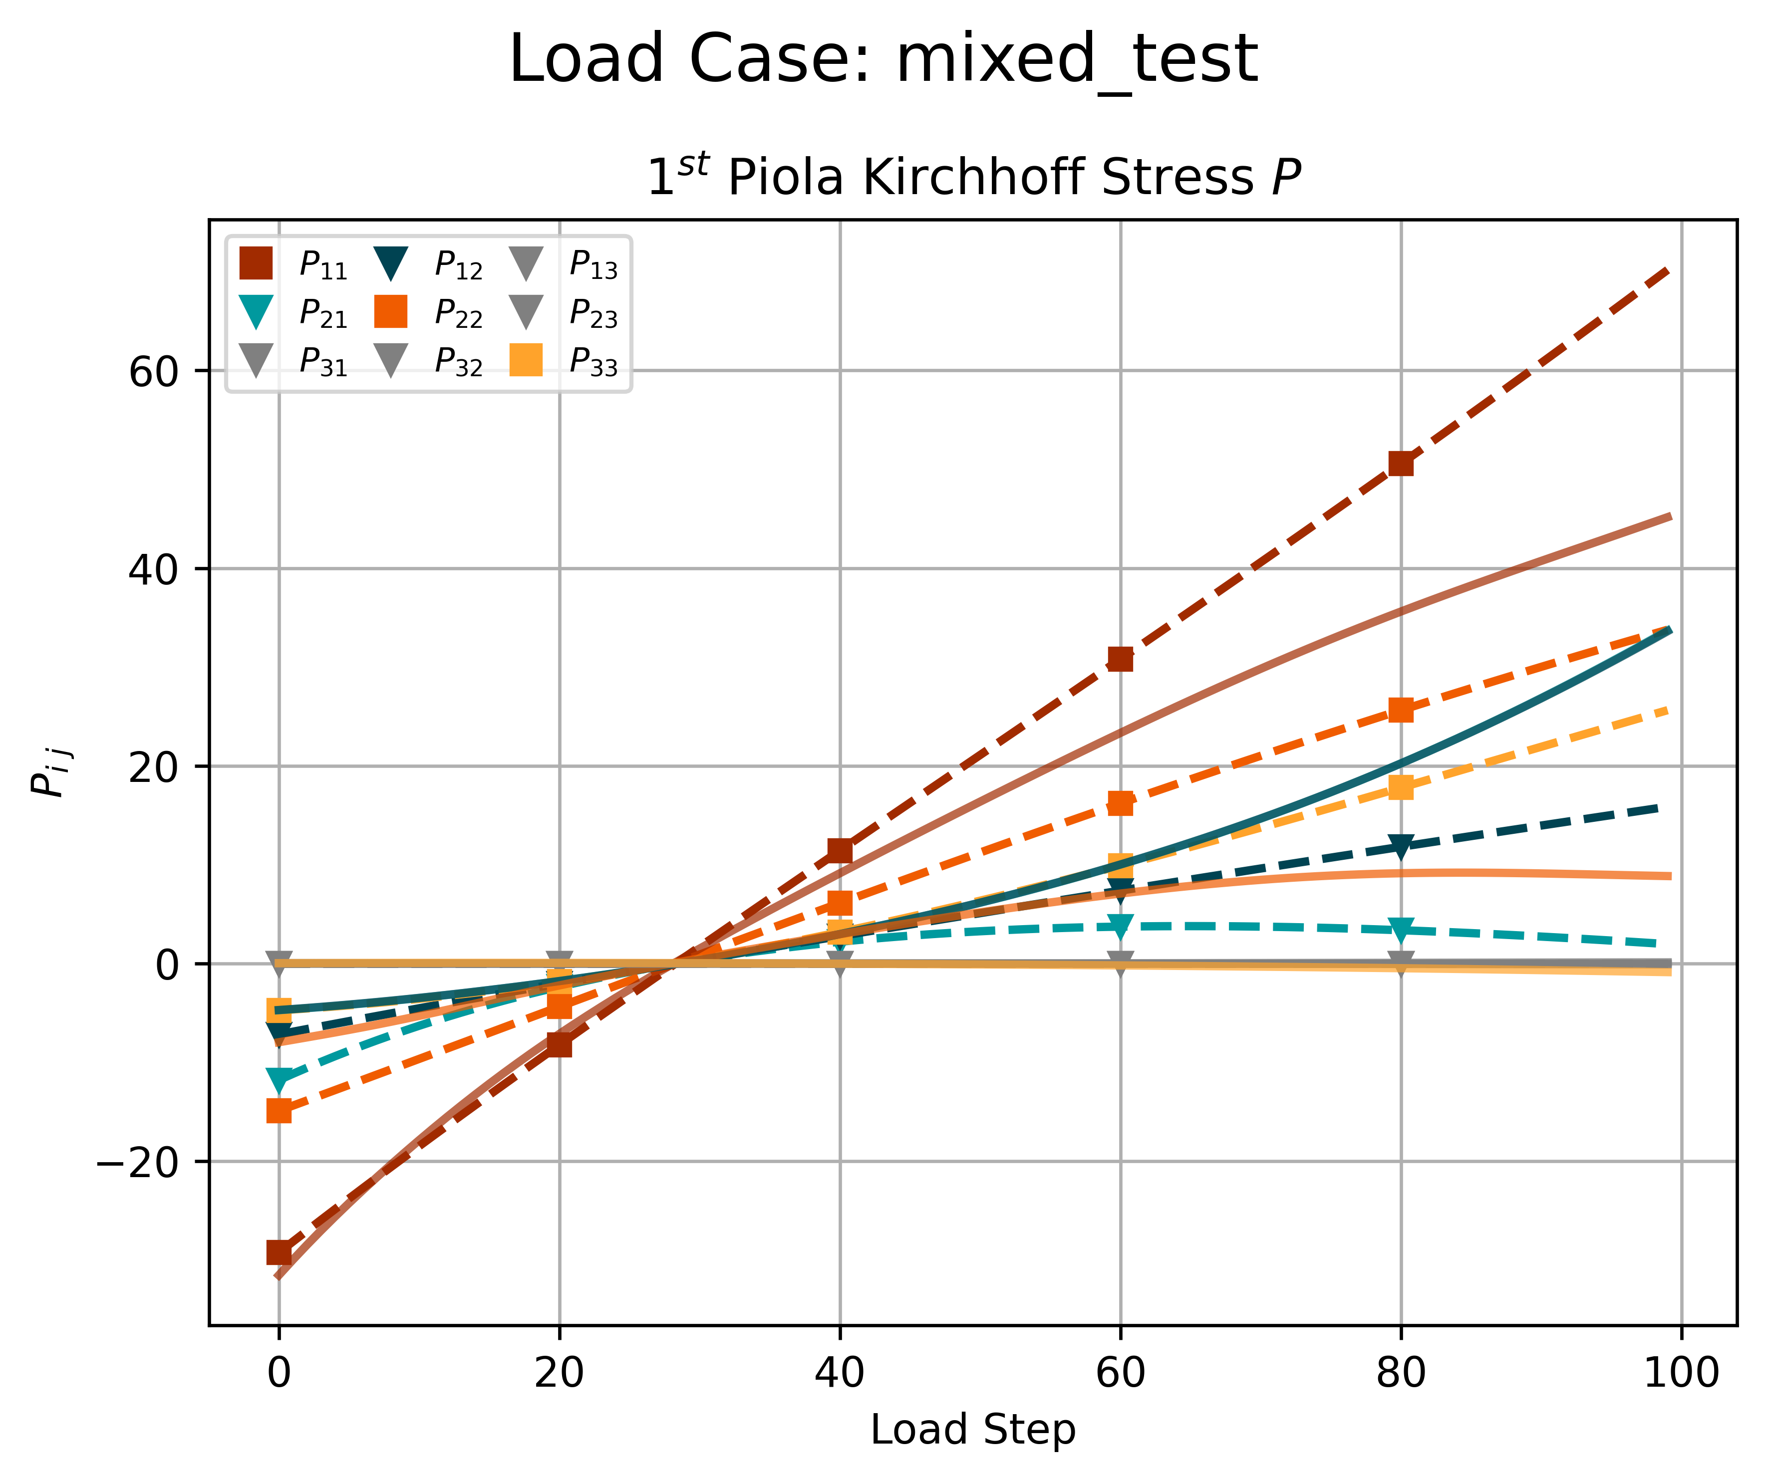
2 – 2.2
Naive Model - Mixed Test

Slide 15
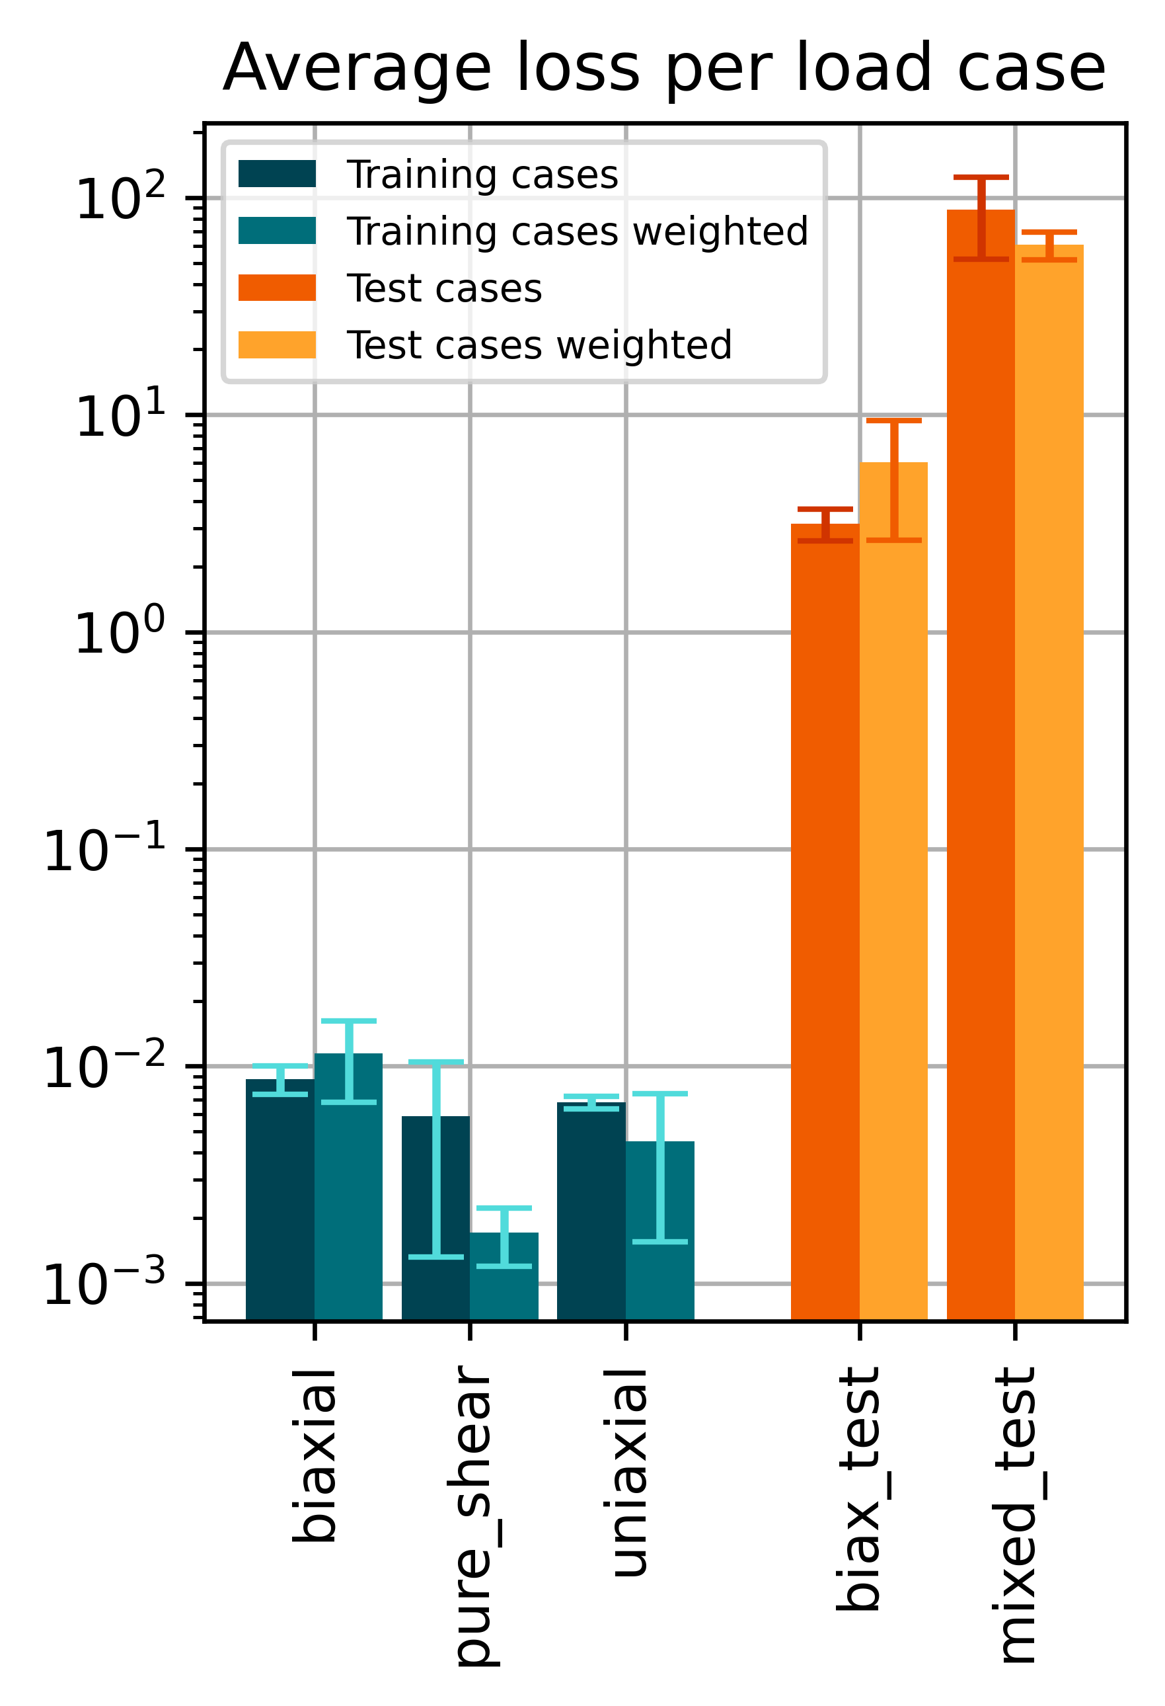
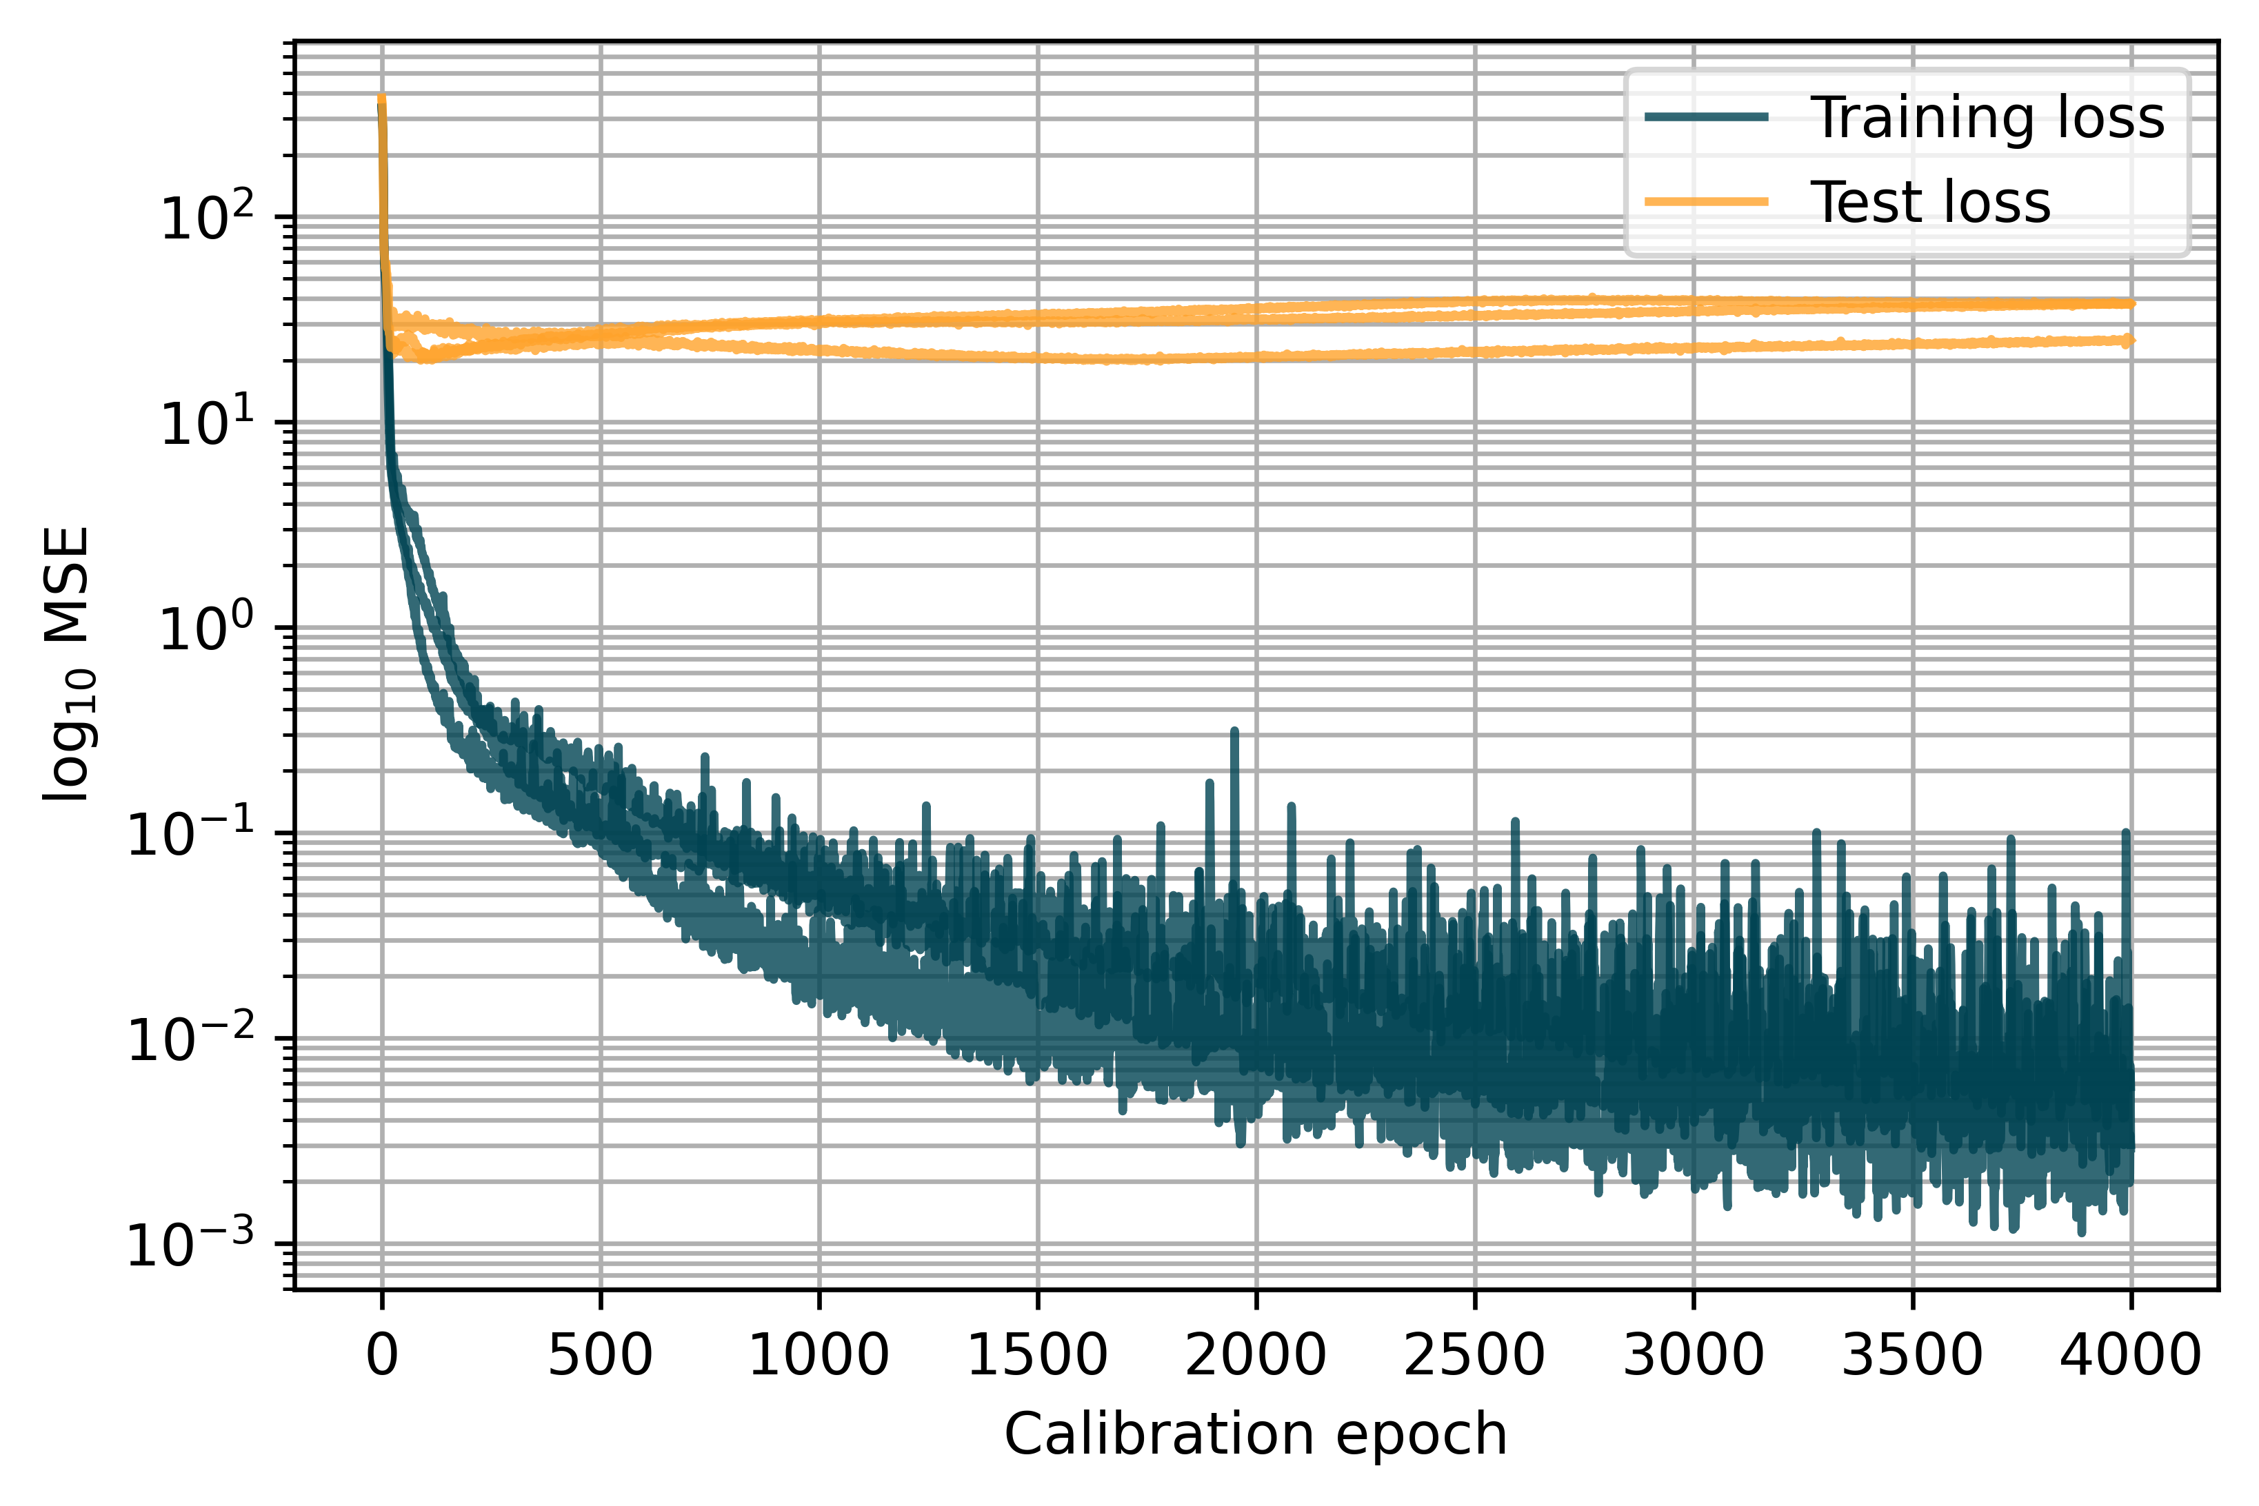
2 – 2.2
Naive Model - Loss weighting strategy
Layers: 16, 16, 9 Epochs: 4000 Learn rate: 0.005

Slide 16
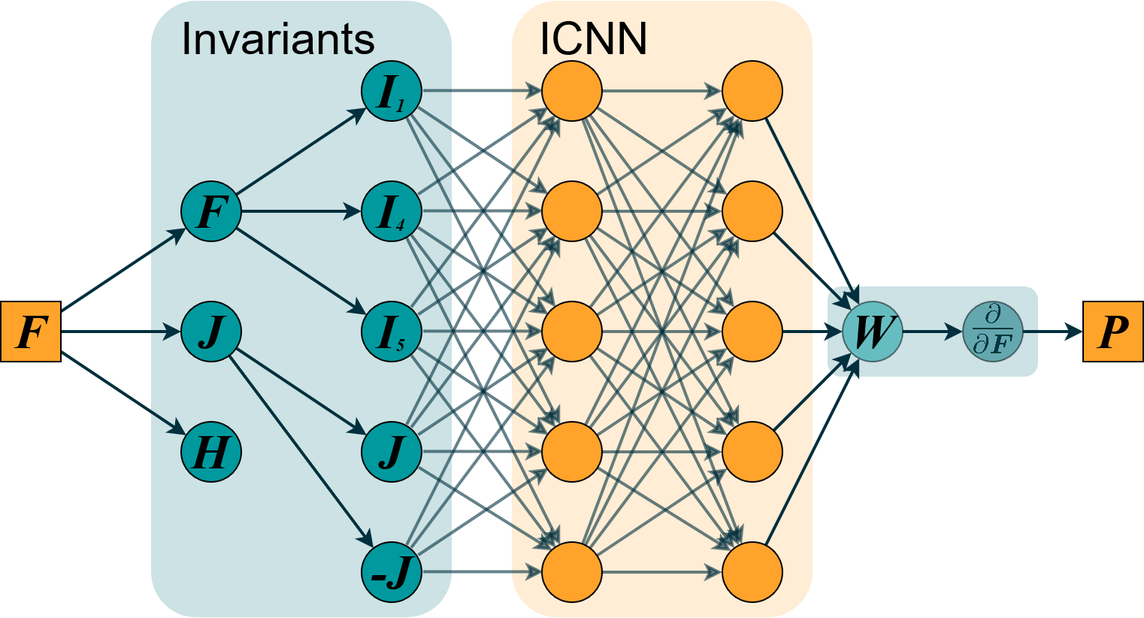
2 – 3.1
Physics-augmented model
Notes:
Why –J, why restriction on first layer of ICNN

Slide 17
2 – 3.1
Physics-augmented model
Physical conditions:
Objectivity
Material Symmetry
Notes:
Why –J, why restriction on first layer of ICNN

Slide 18
2 – 3.1
Physics-augmented model
Physical conditions:
Objectivity
Material Symmetry
Thermodynamics
Notes:
Why –J, why restriction on first layer of ICNN

Slide 19
2 – 3.1
Physics-augmented model
Physical conditions:
Objectivity
Material Symmetry
Thermodynamics
Polyconvexity/Ellipticity
Notes:
Why –J, why restriction on first layer of ICNN

Slide 20
2 – 3.1
Physics-augmented model
Physical conditions:
Objectivity
Material Symmetry
Thermodynamics
Polyconvexity/Ellipticity
Normalization
Growth Condition
Notes:
Why –J, why restriction on first layer of ICNN

Slide 21
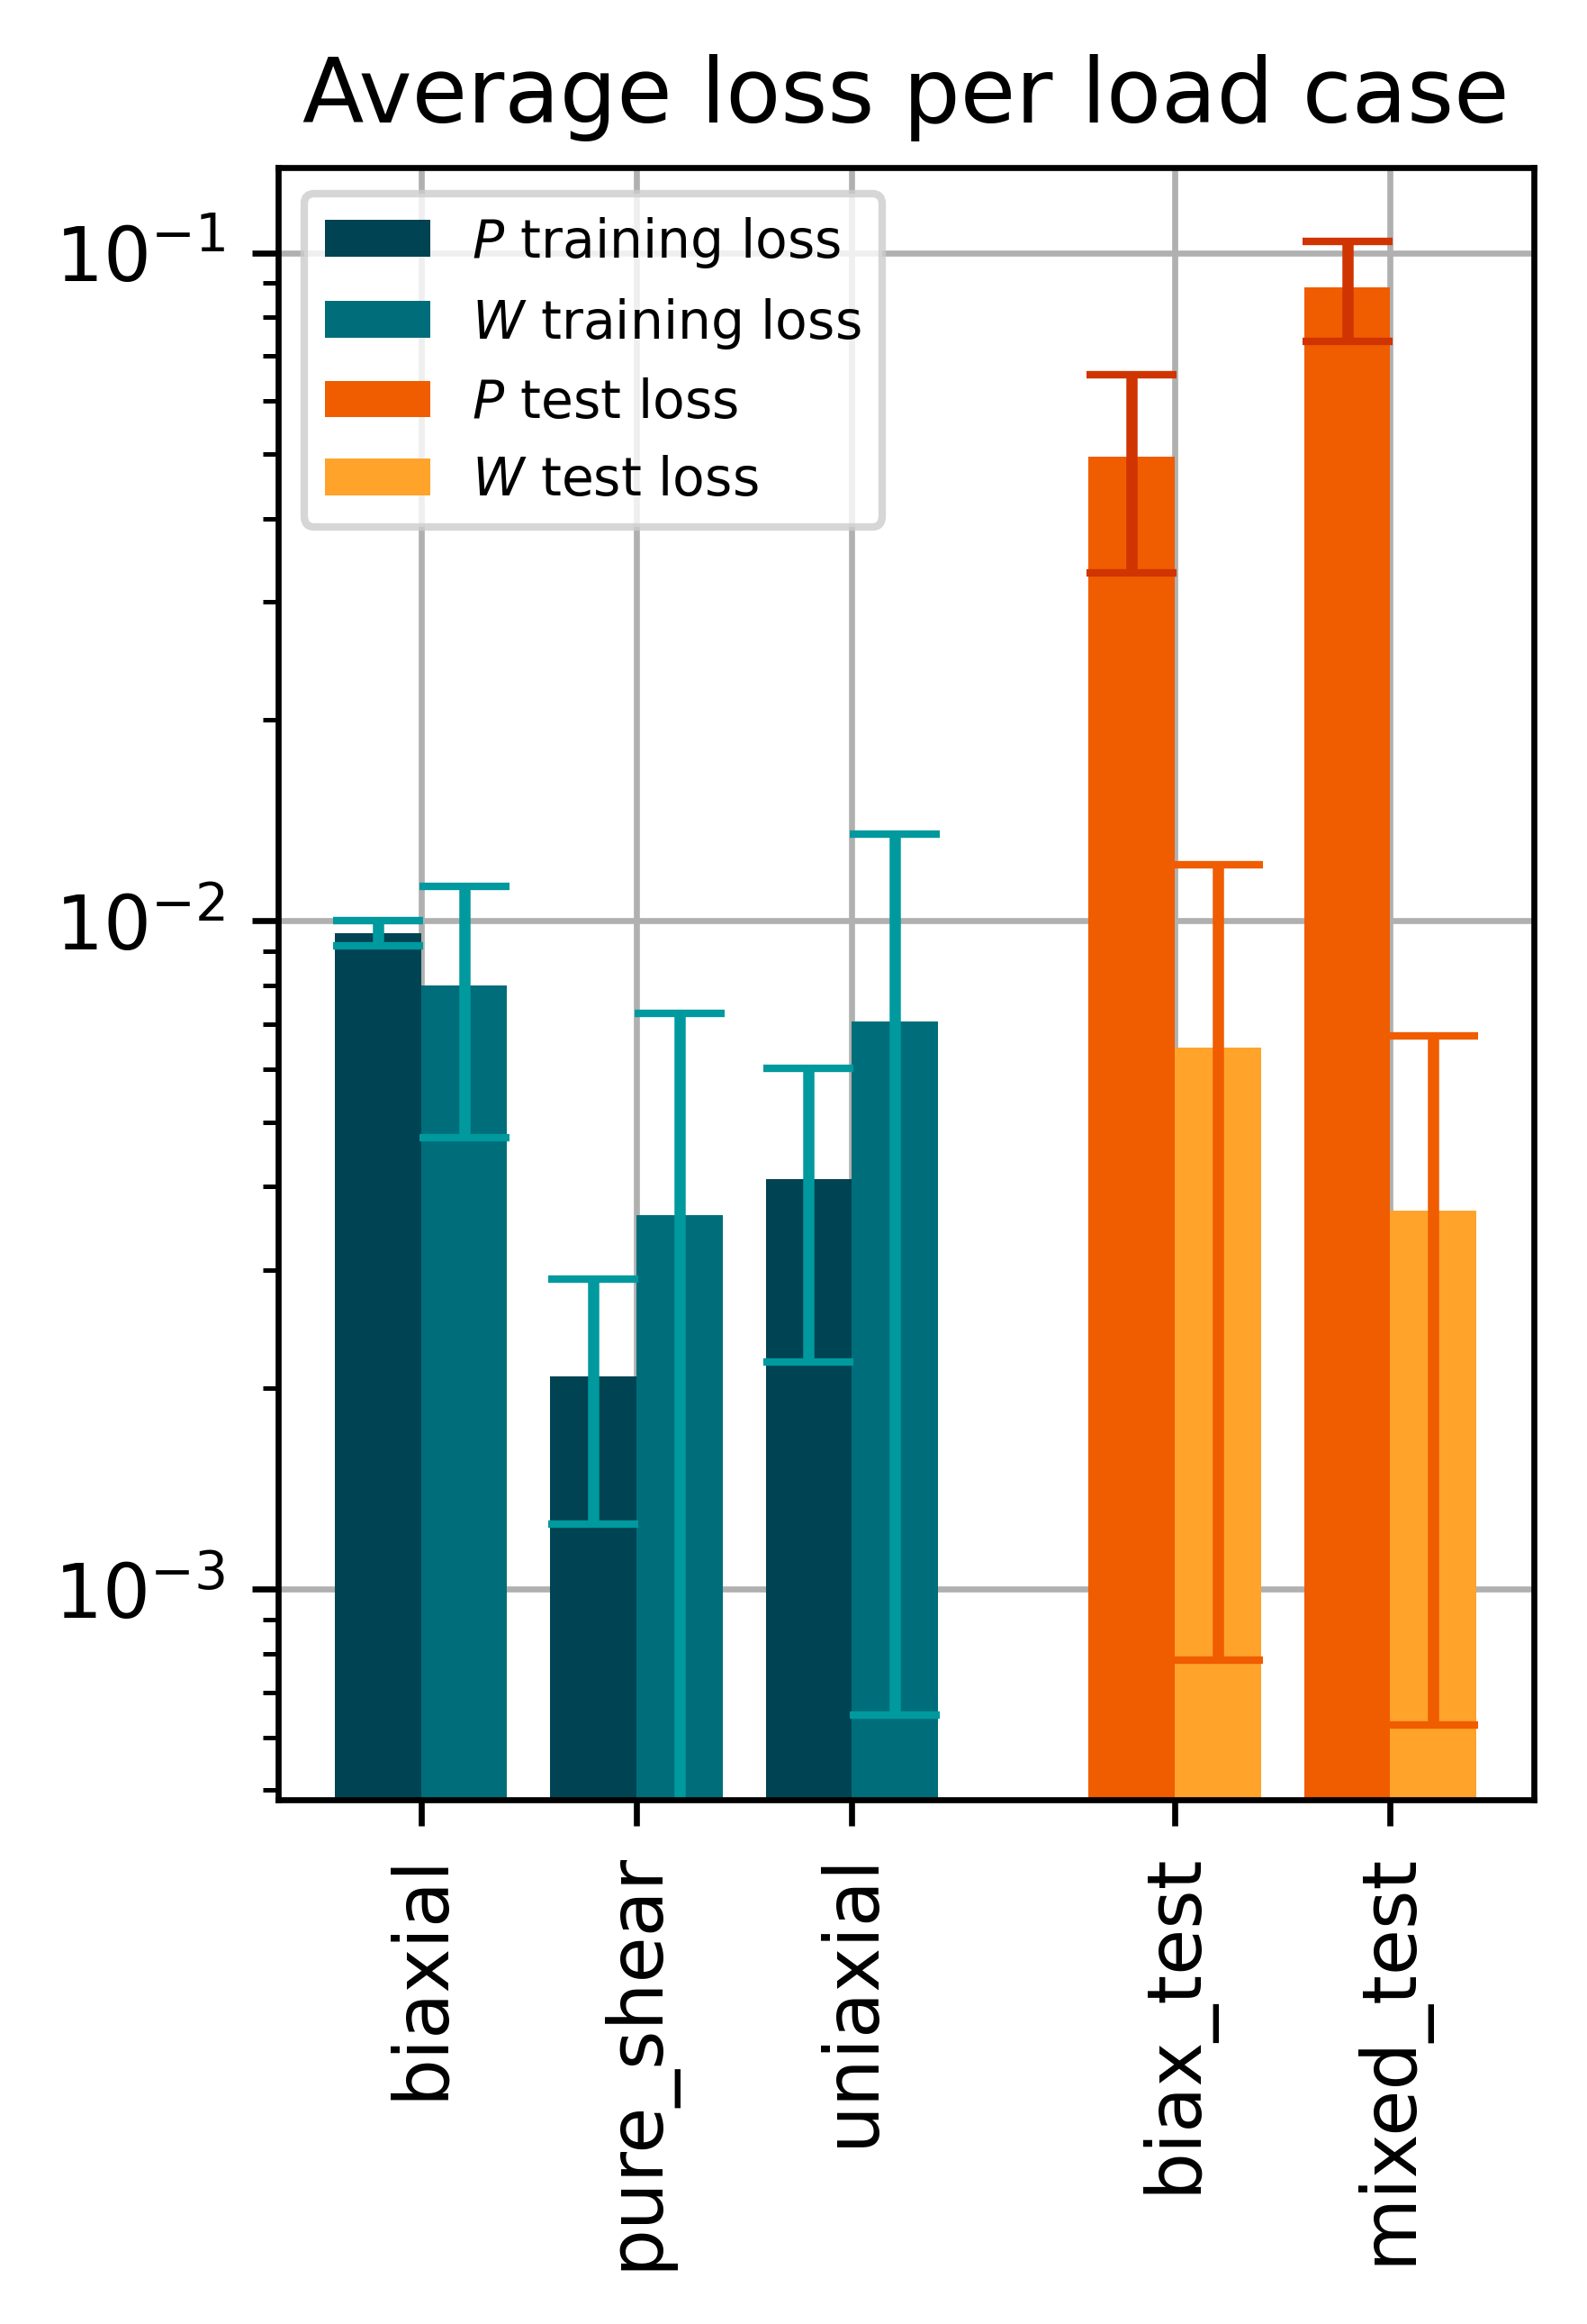
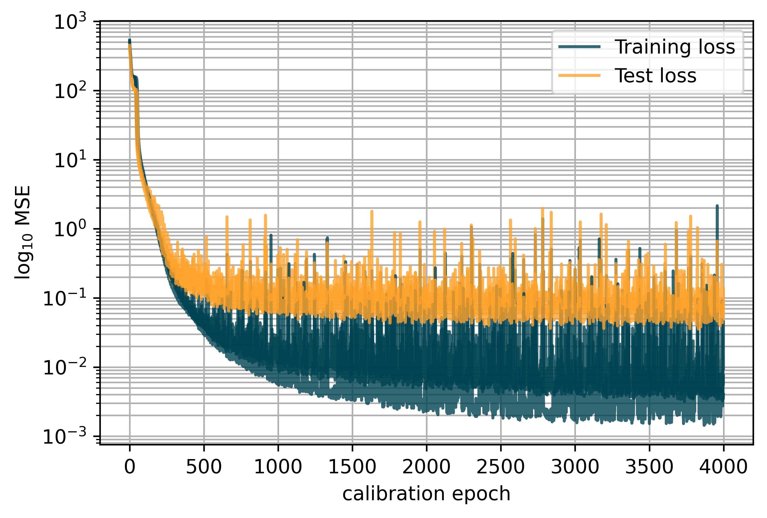
2 – 3.2
Physics-augmented model
3 Instances Trained on: P and W
Layers: 16, 16, 1 Epochs: 4000 Learn rate: 0.005

Slide 22
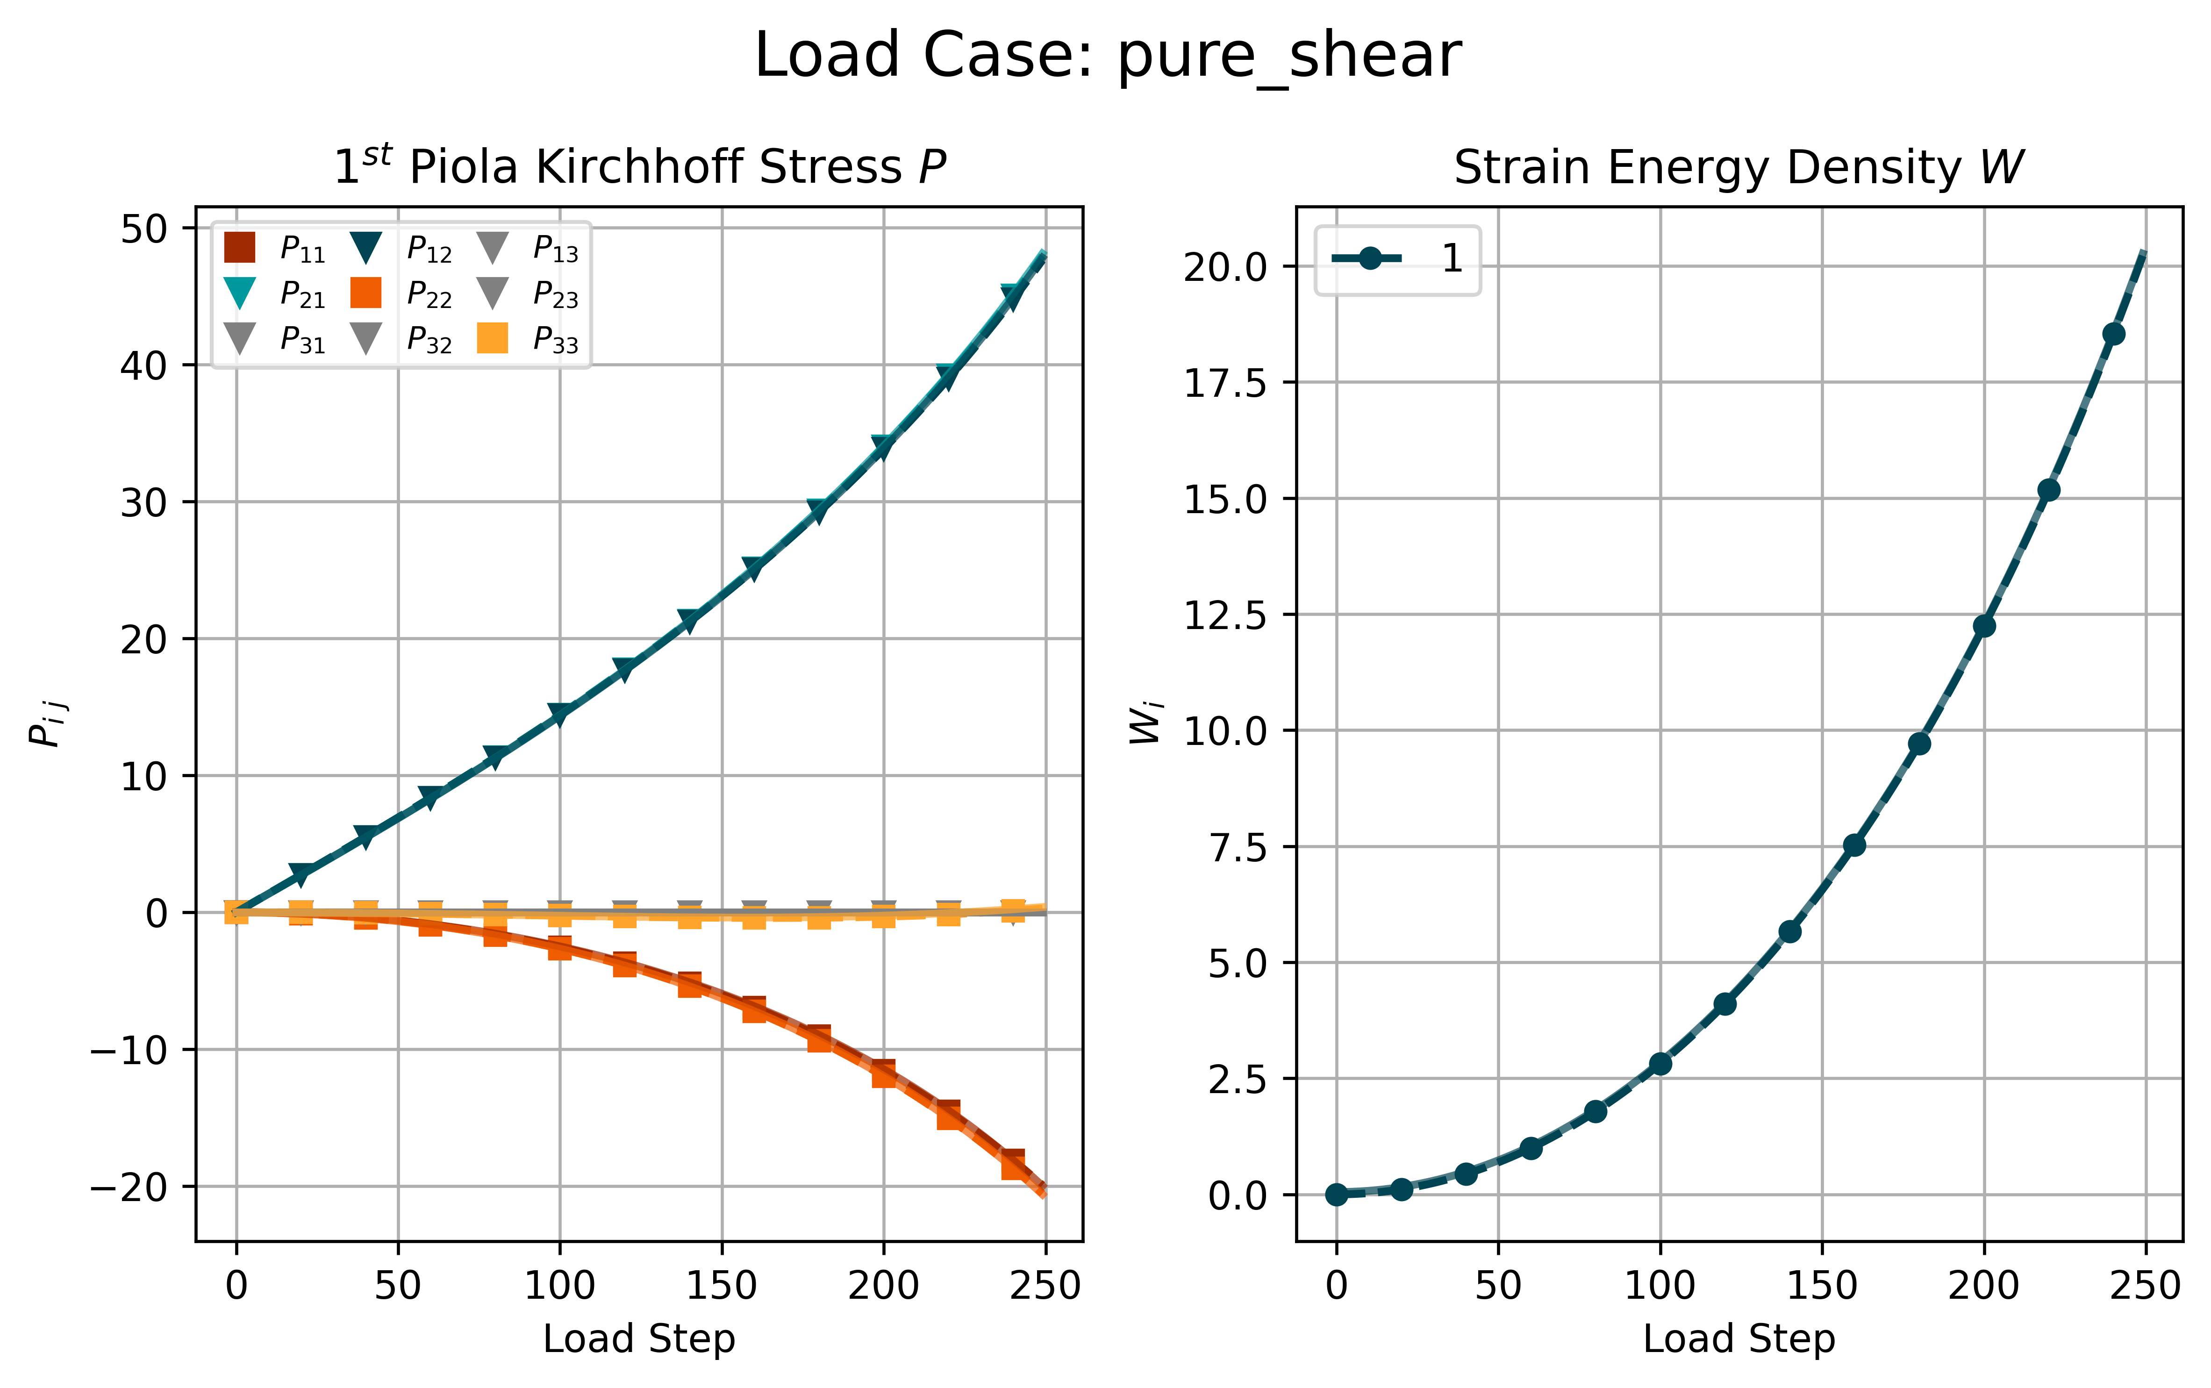
2 – 3.2
Physics-augmented model

Slide 23
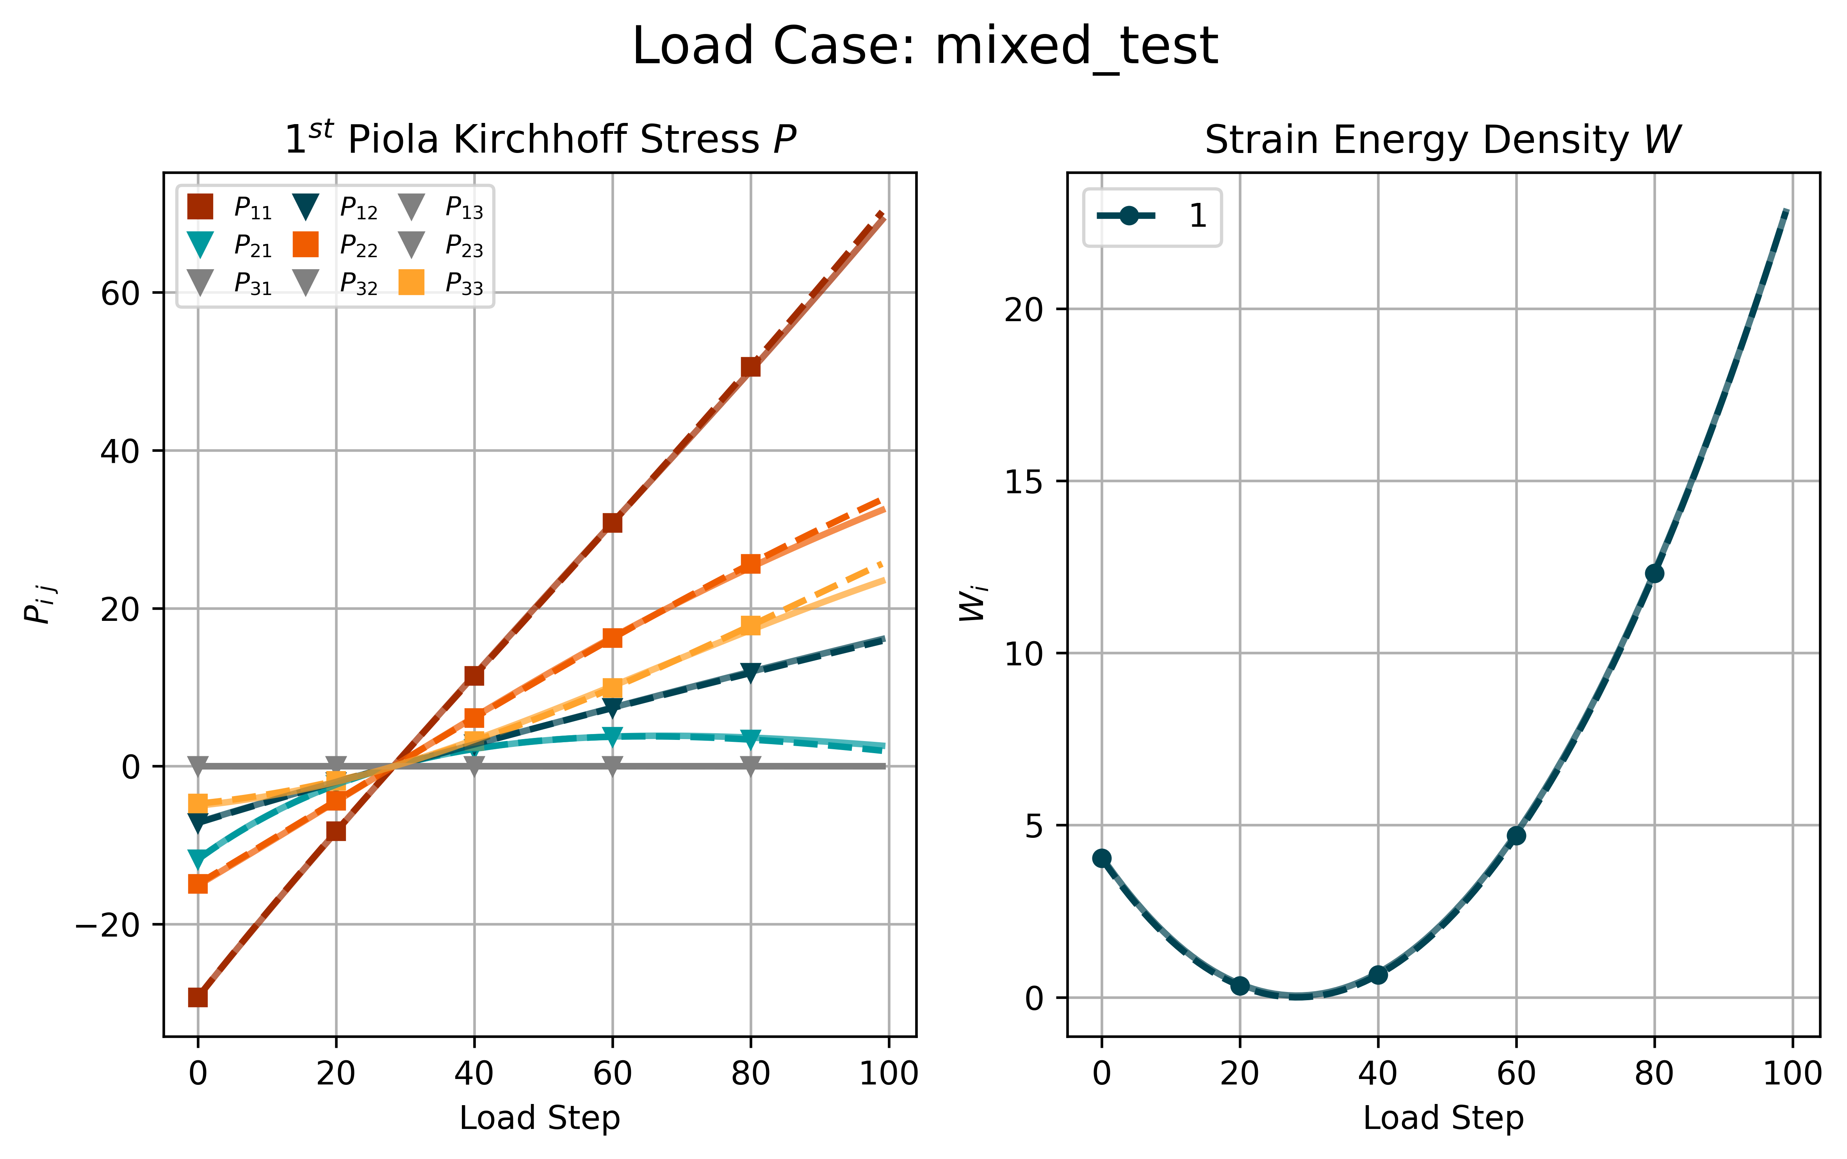
2 – 3.2
Physics-augmented model
Notes:
Also talk about normalization

Slide 24
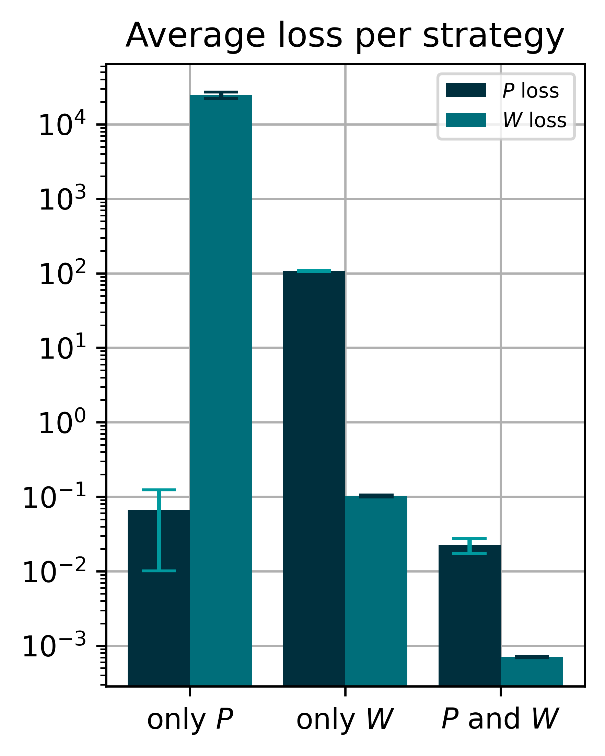
2 – 3.2
Training Strategies
2 Instances Evaluated on all Load Cases
Layers: 16, 16, 1 Epochs: 4000 Learn rate: 0.005

Slide 25
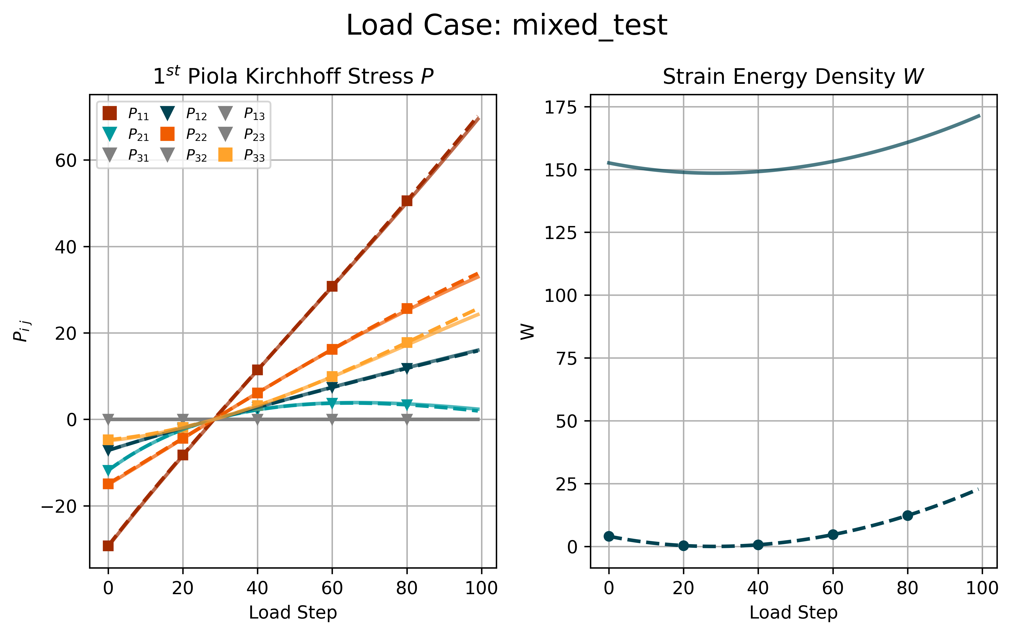
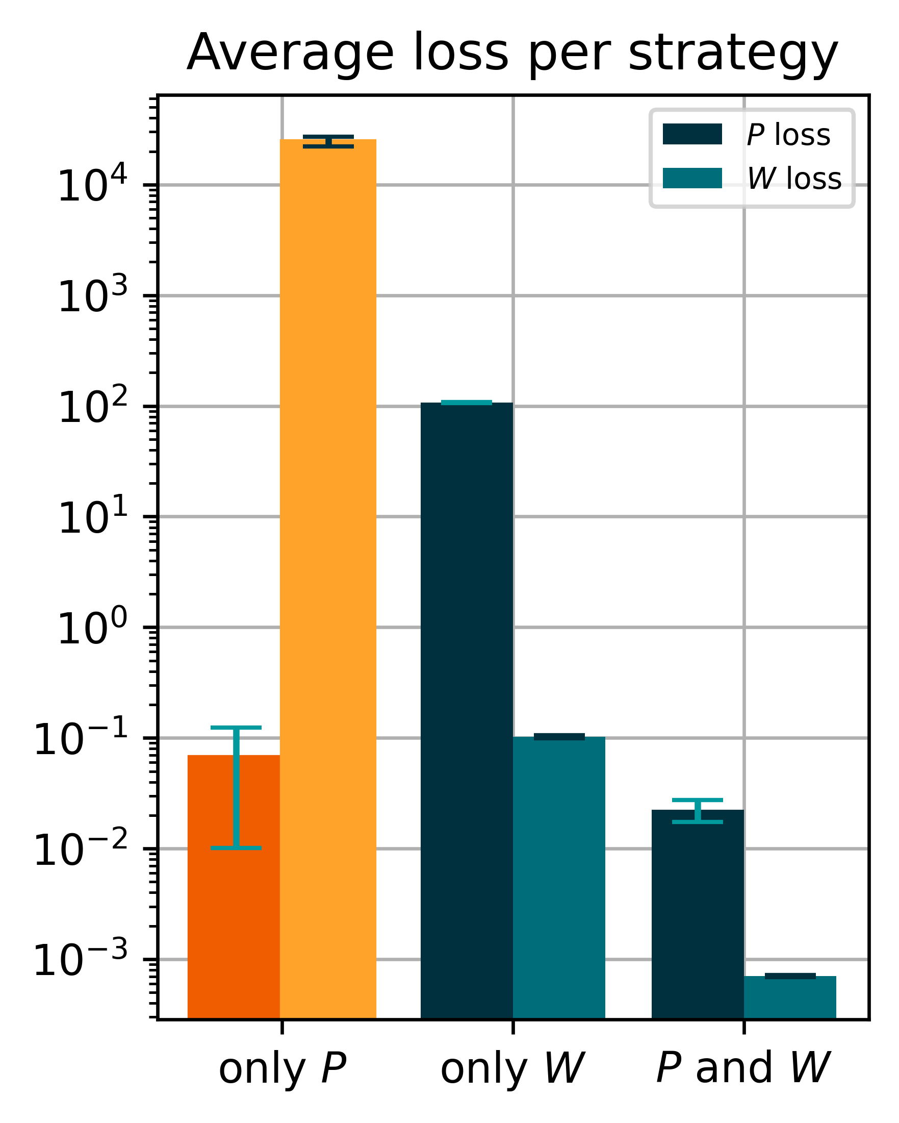
2 – 3.2
Training Strategies
2 Instances Evaluated on all Load Cases
Layers: 16, 16, 1 Epochs: 4000 Learn rate: 0.005

Slide 26
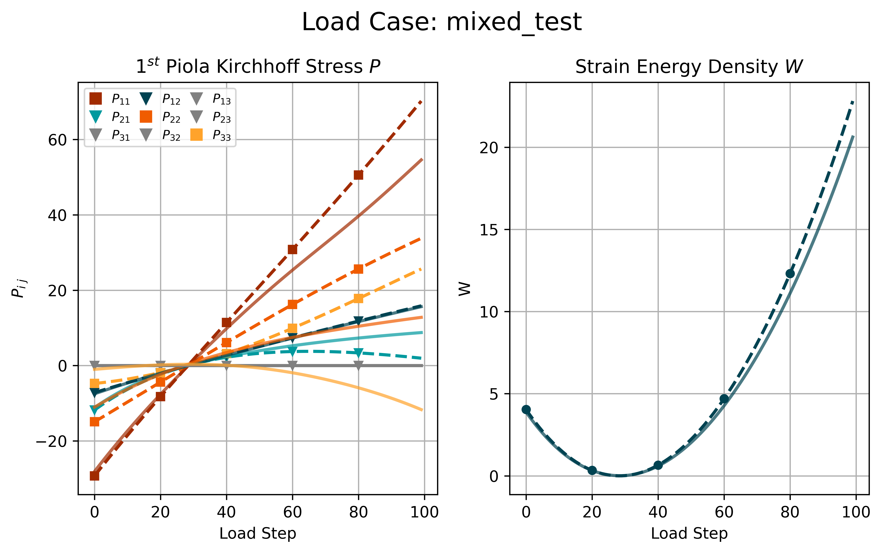
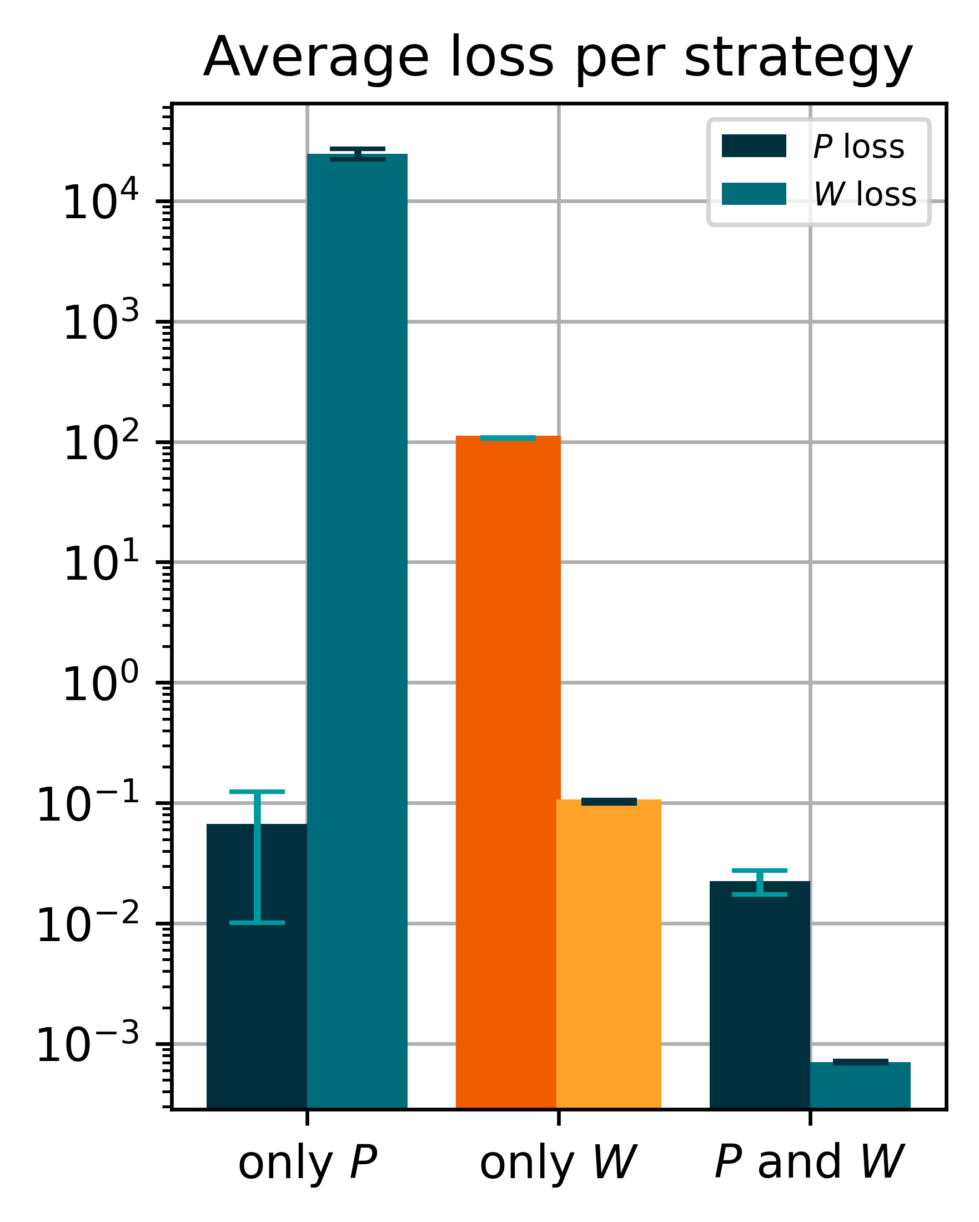
2 – 3.2
Training Strategies
2 Instances Evaluated on all Load Cases
Layers: 16, 16, 1 Epochs: 4000 Learn rate: 0.005

Slide 27
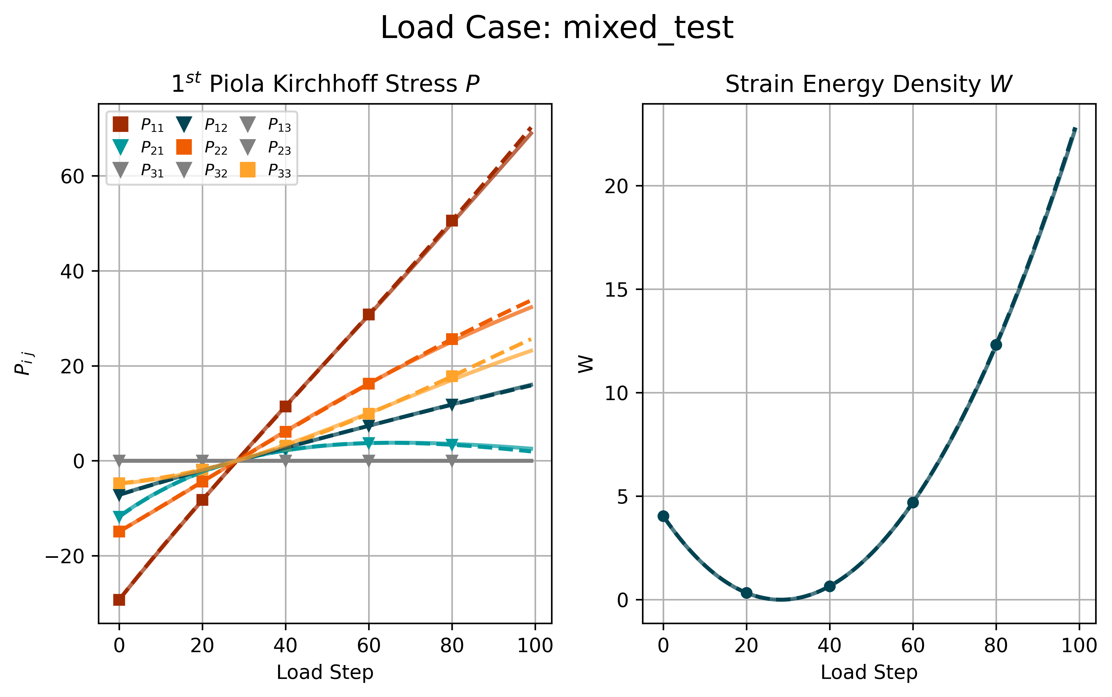
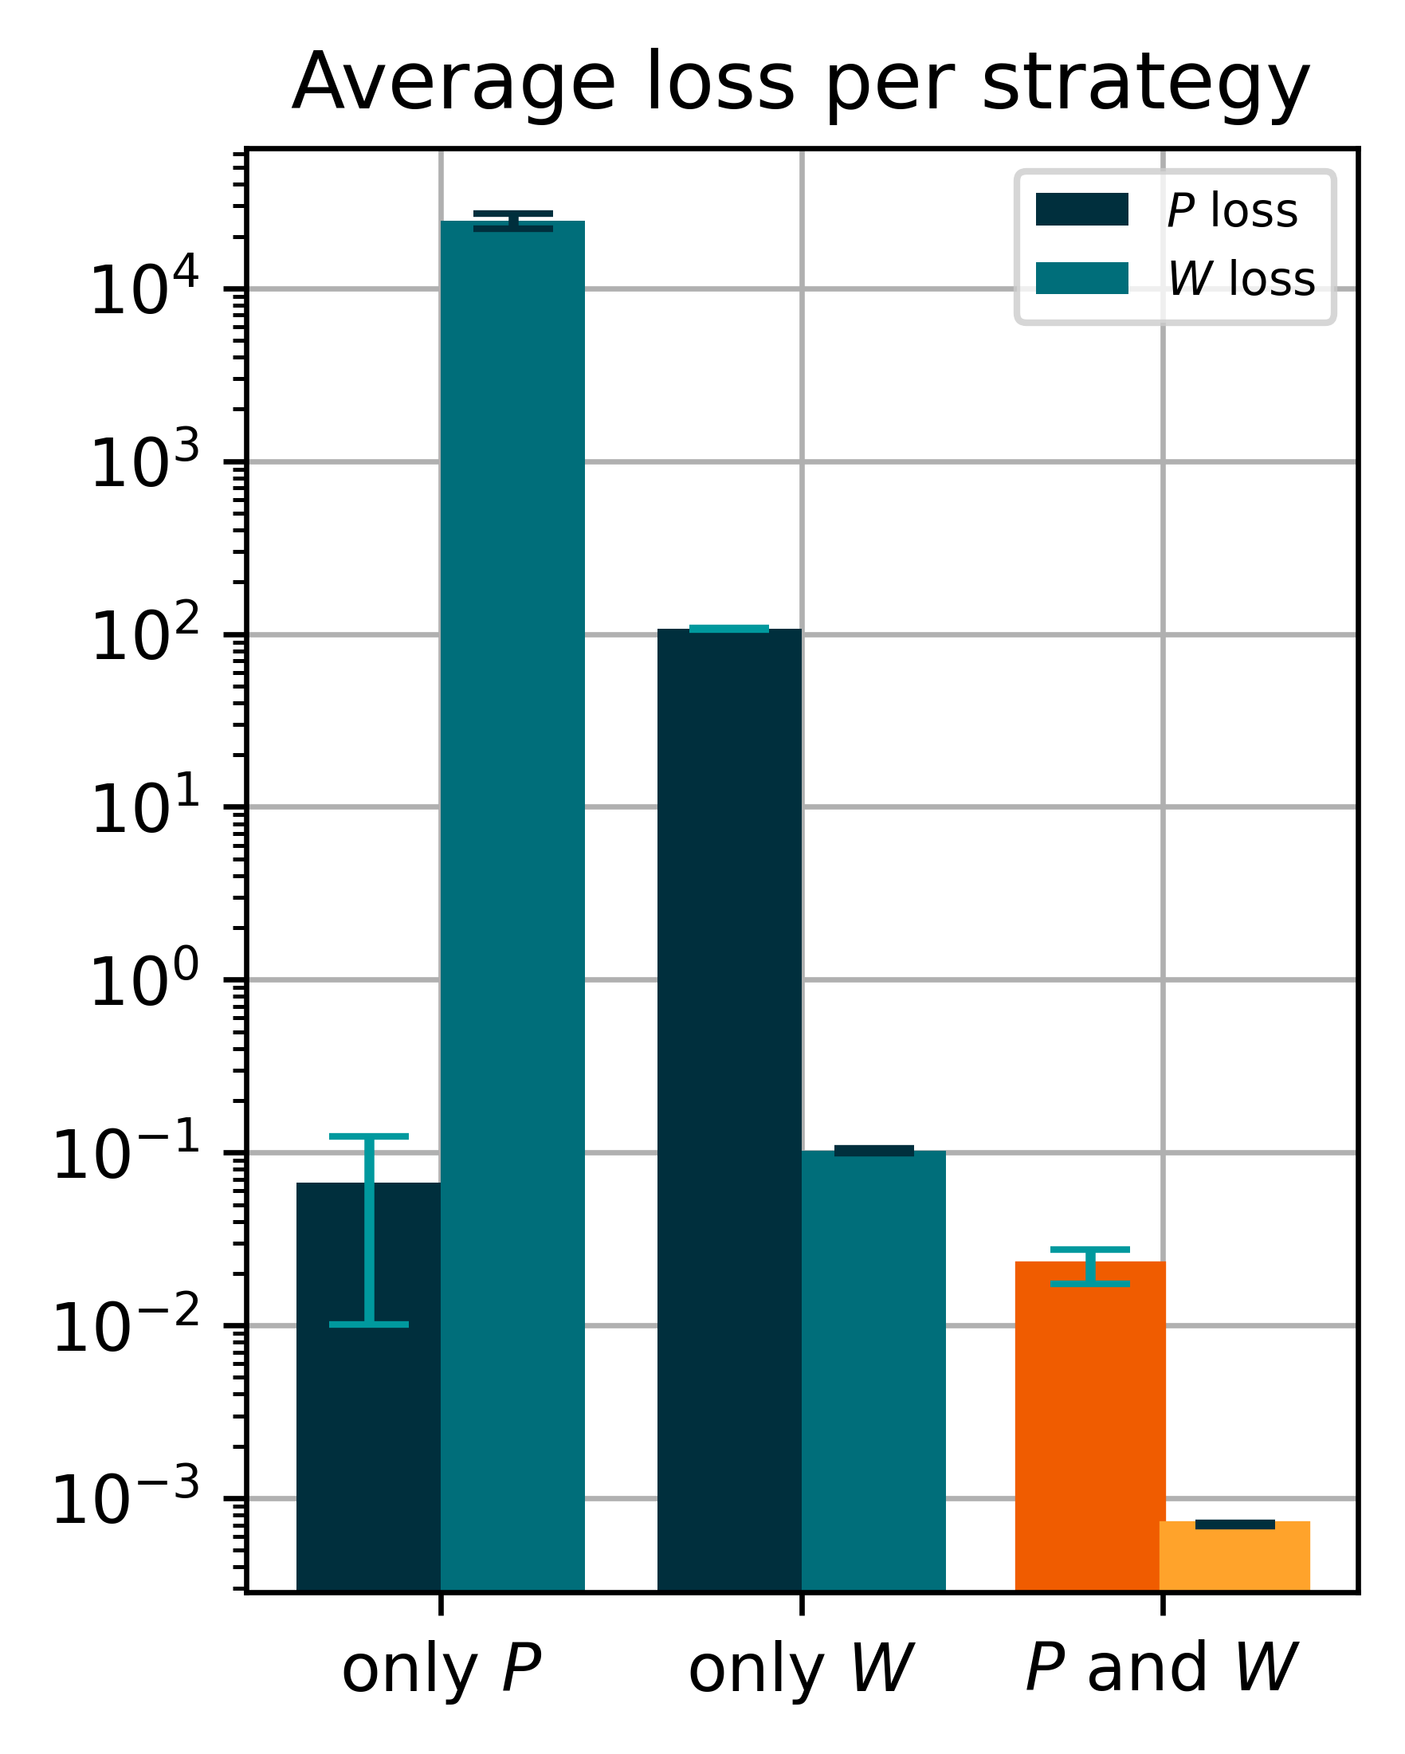
2 – 3.2
Training Strategies
2 Instances Evaluated on all Load Cases
Layers: 16, 16, 1 Epochs: 4000 Learn rate: 0.005

Slide 28
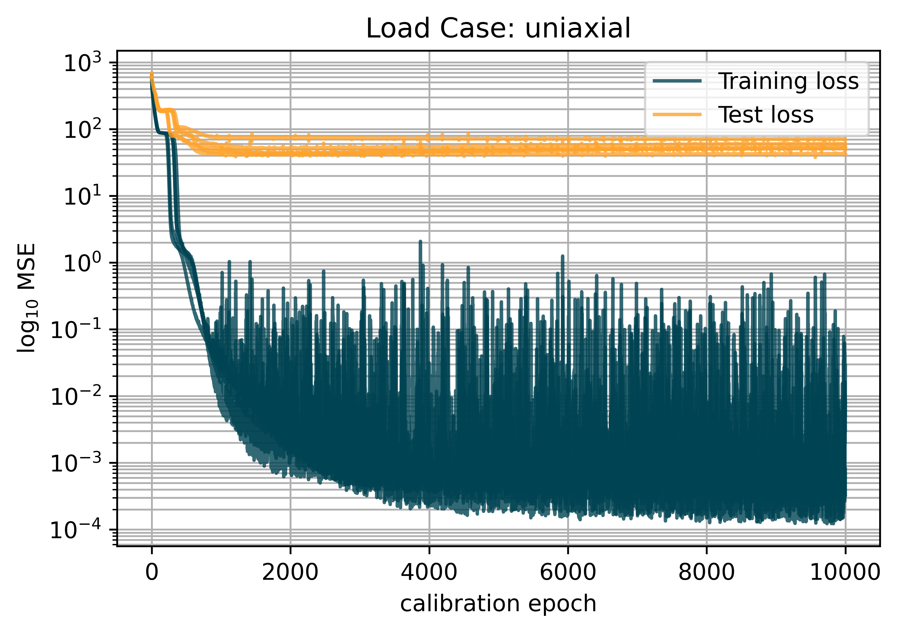
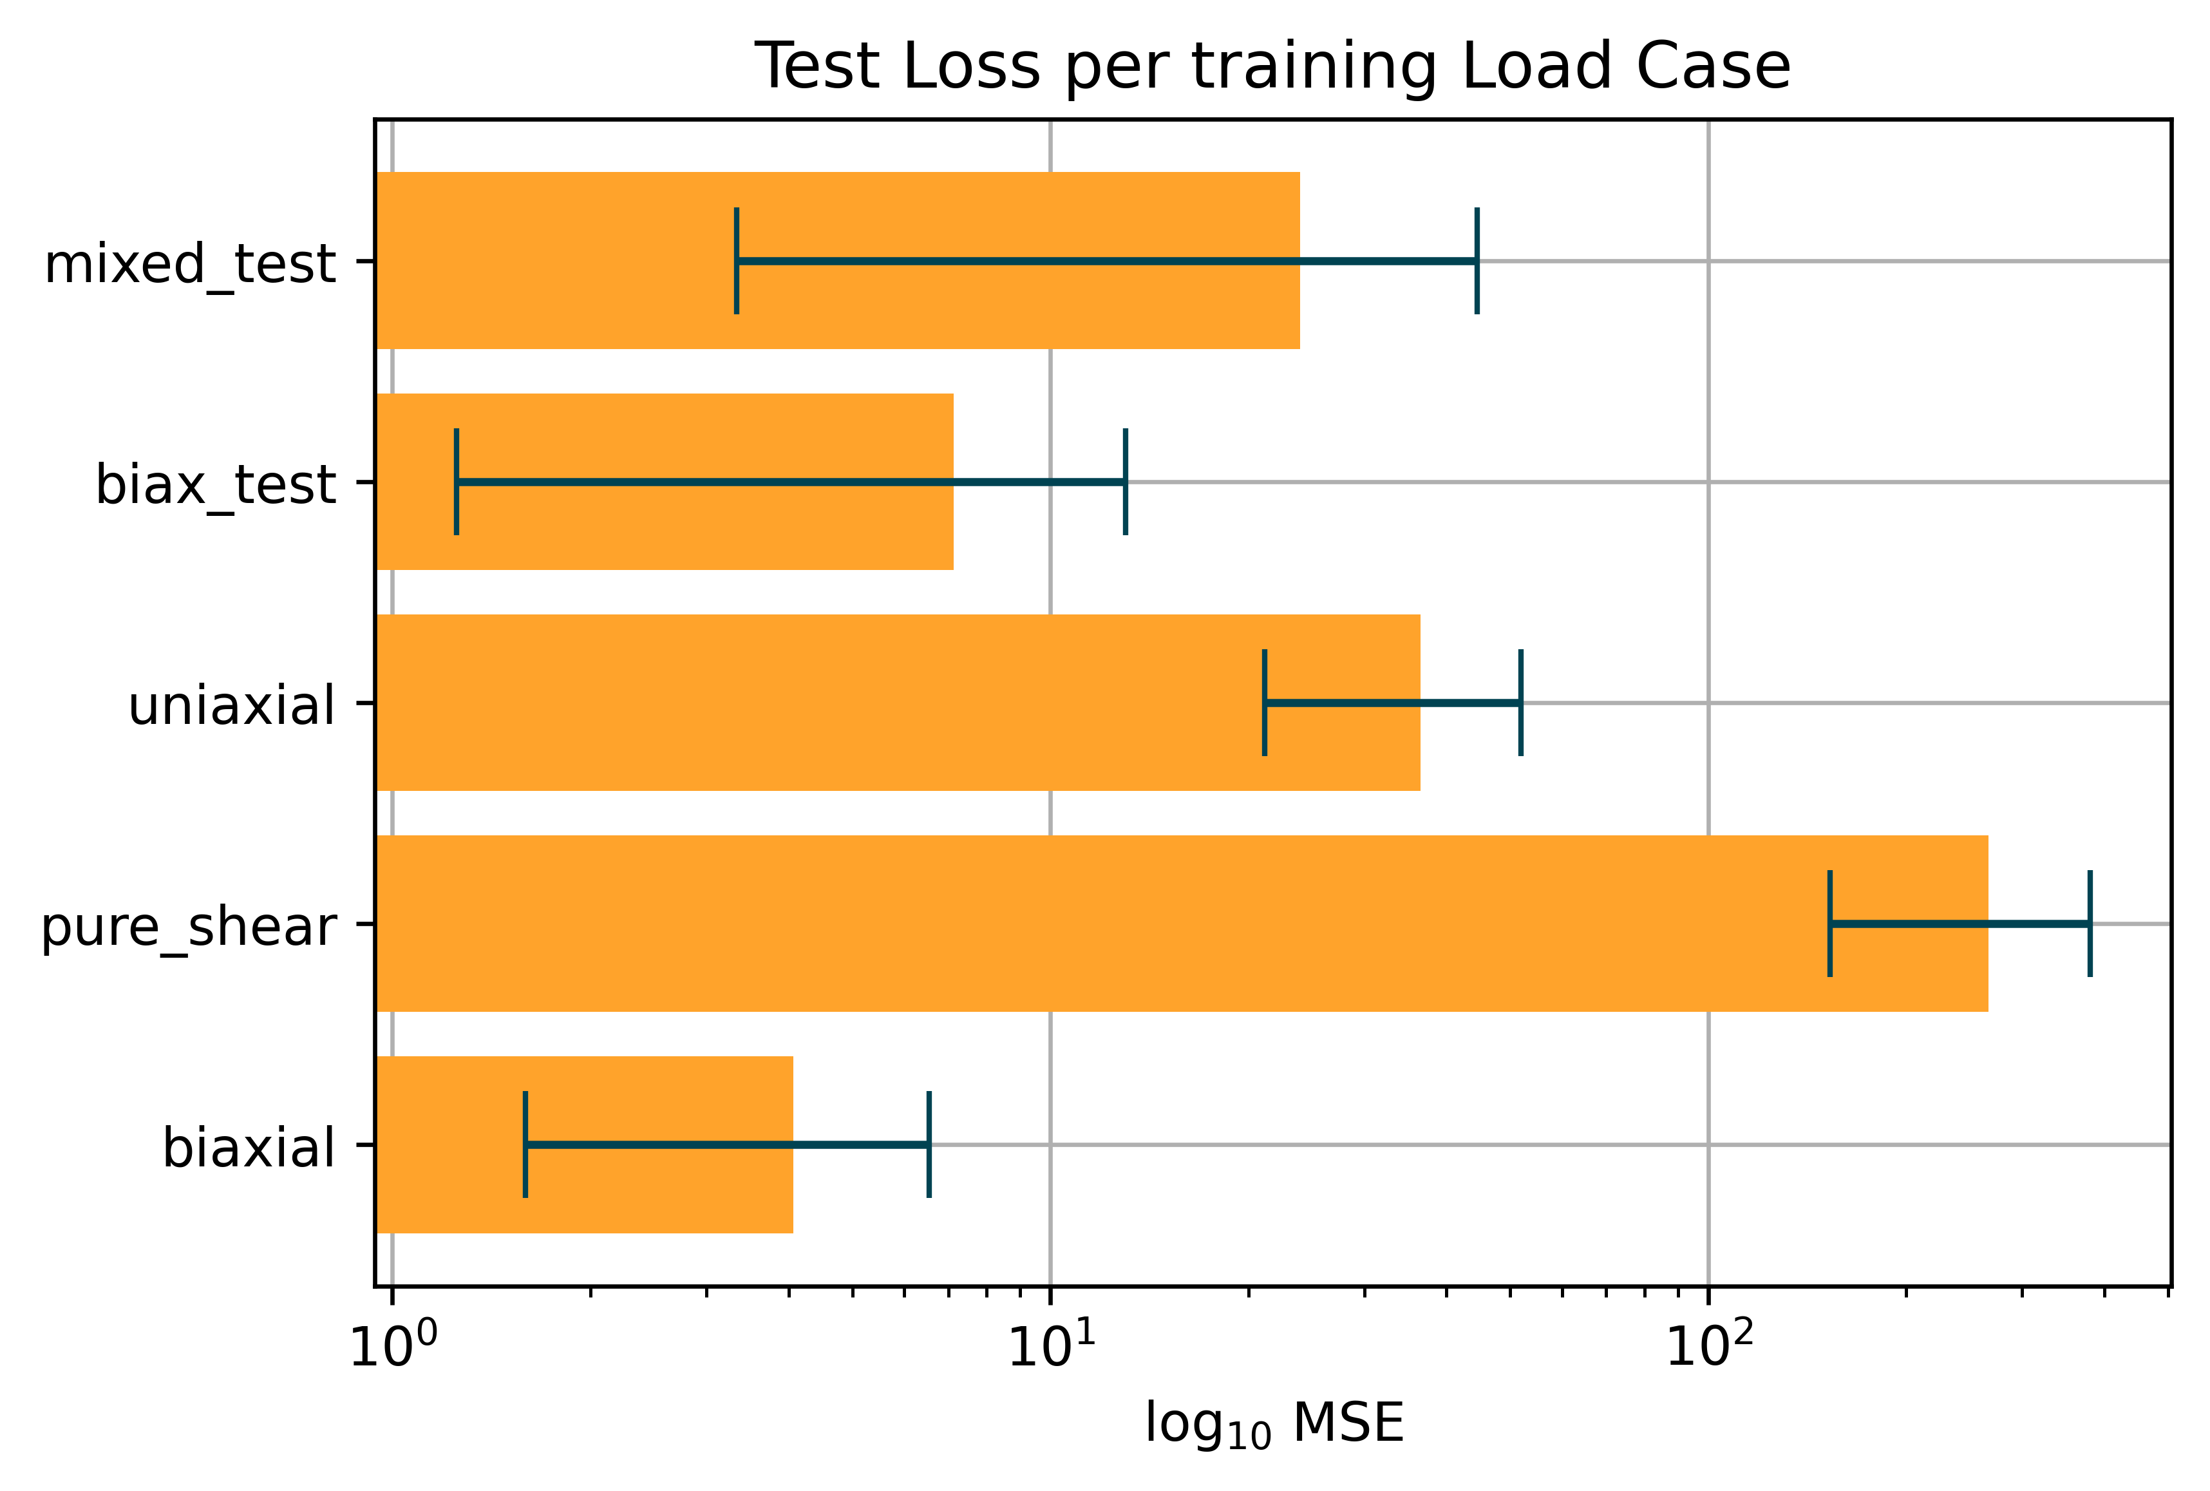
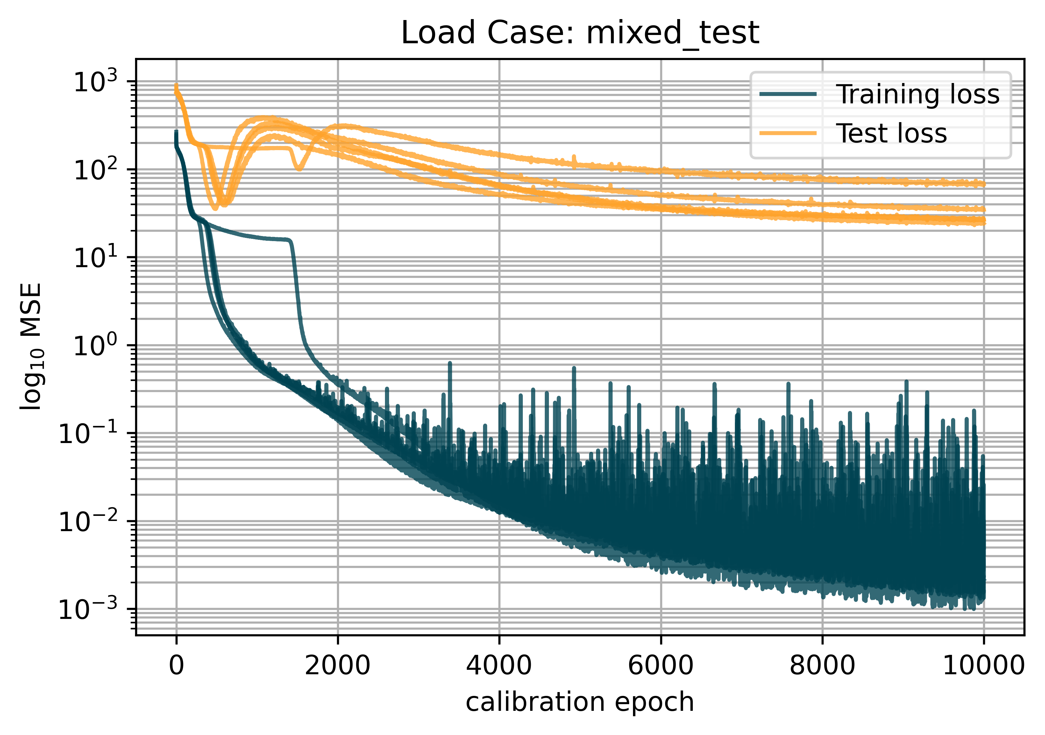
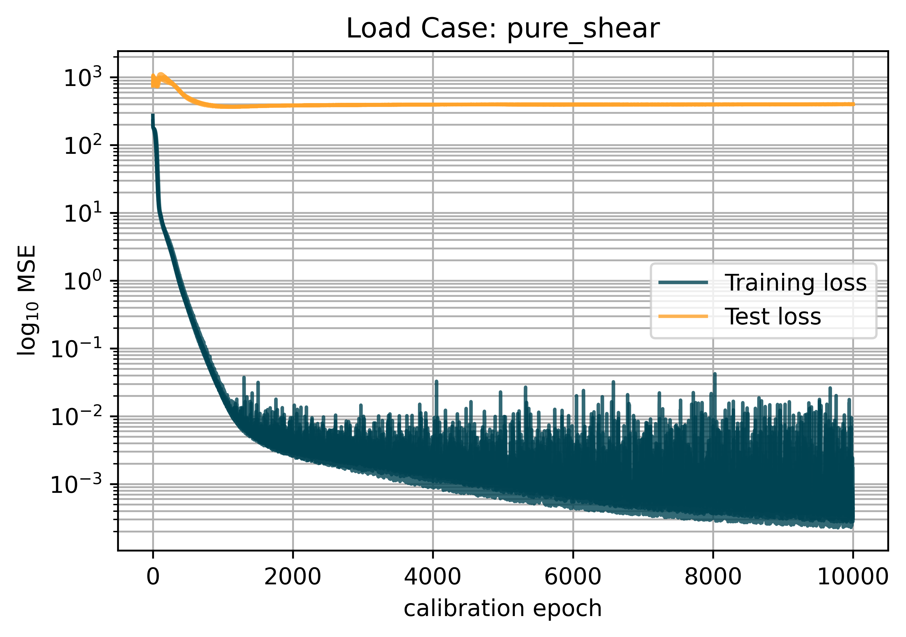
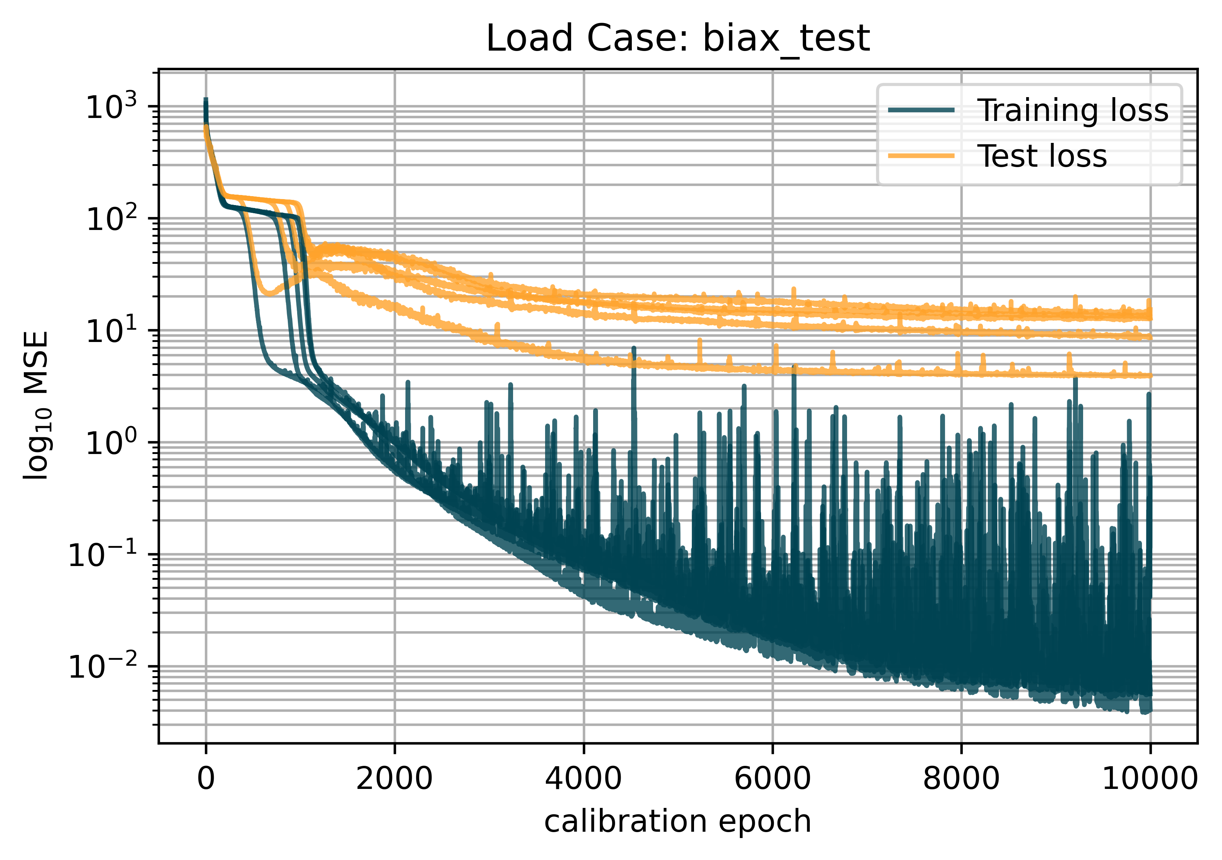
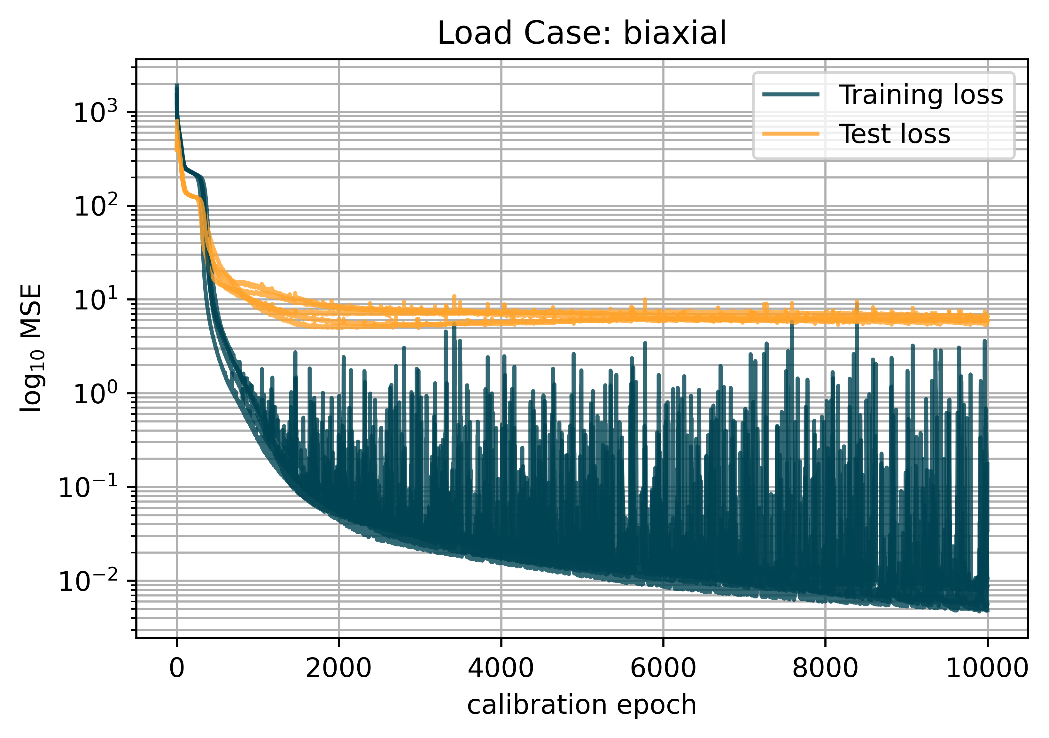
2 – 3.2
Single Load Case Training
5 Instances each
Layers 16, 16, 1 Epochs: 10,000 Learning rate: 0.003
Trained on: P and W

Slide 29
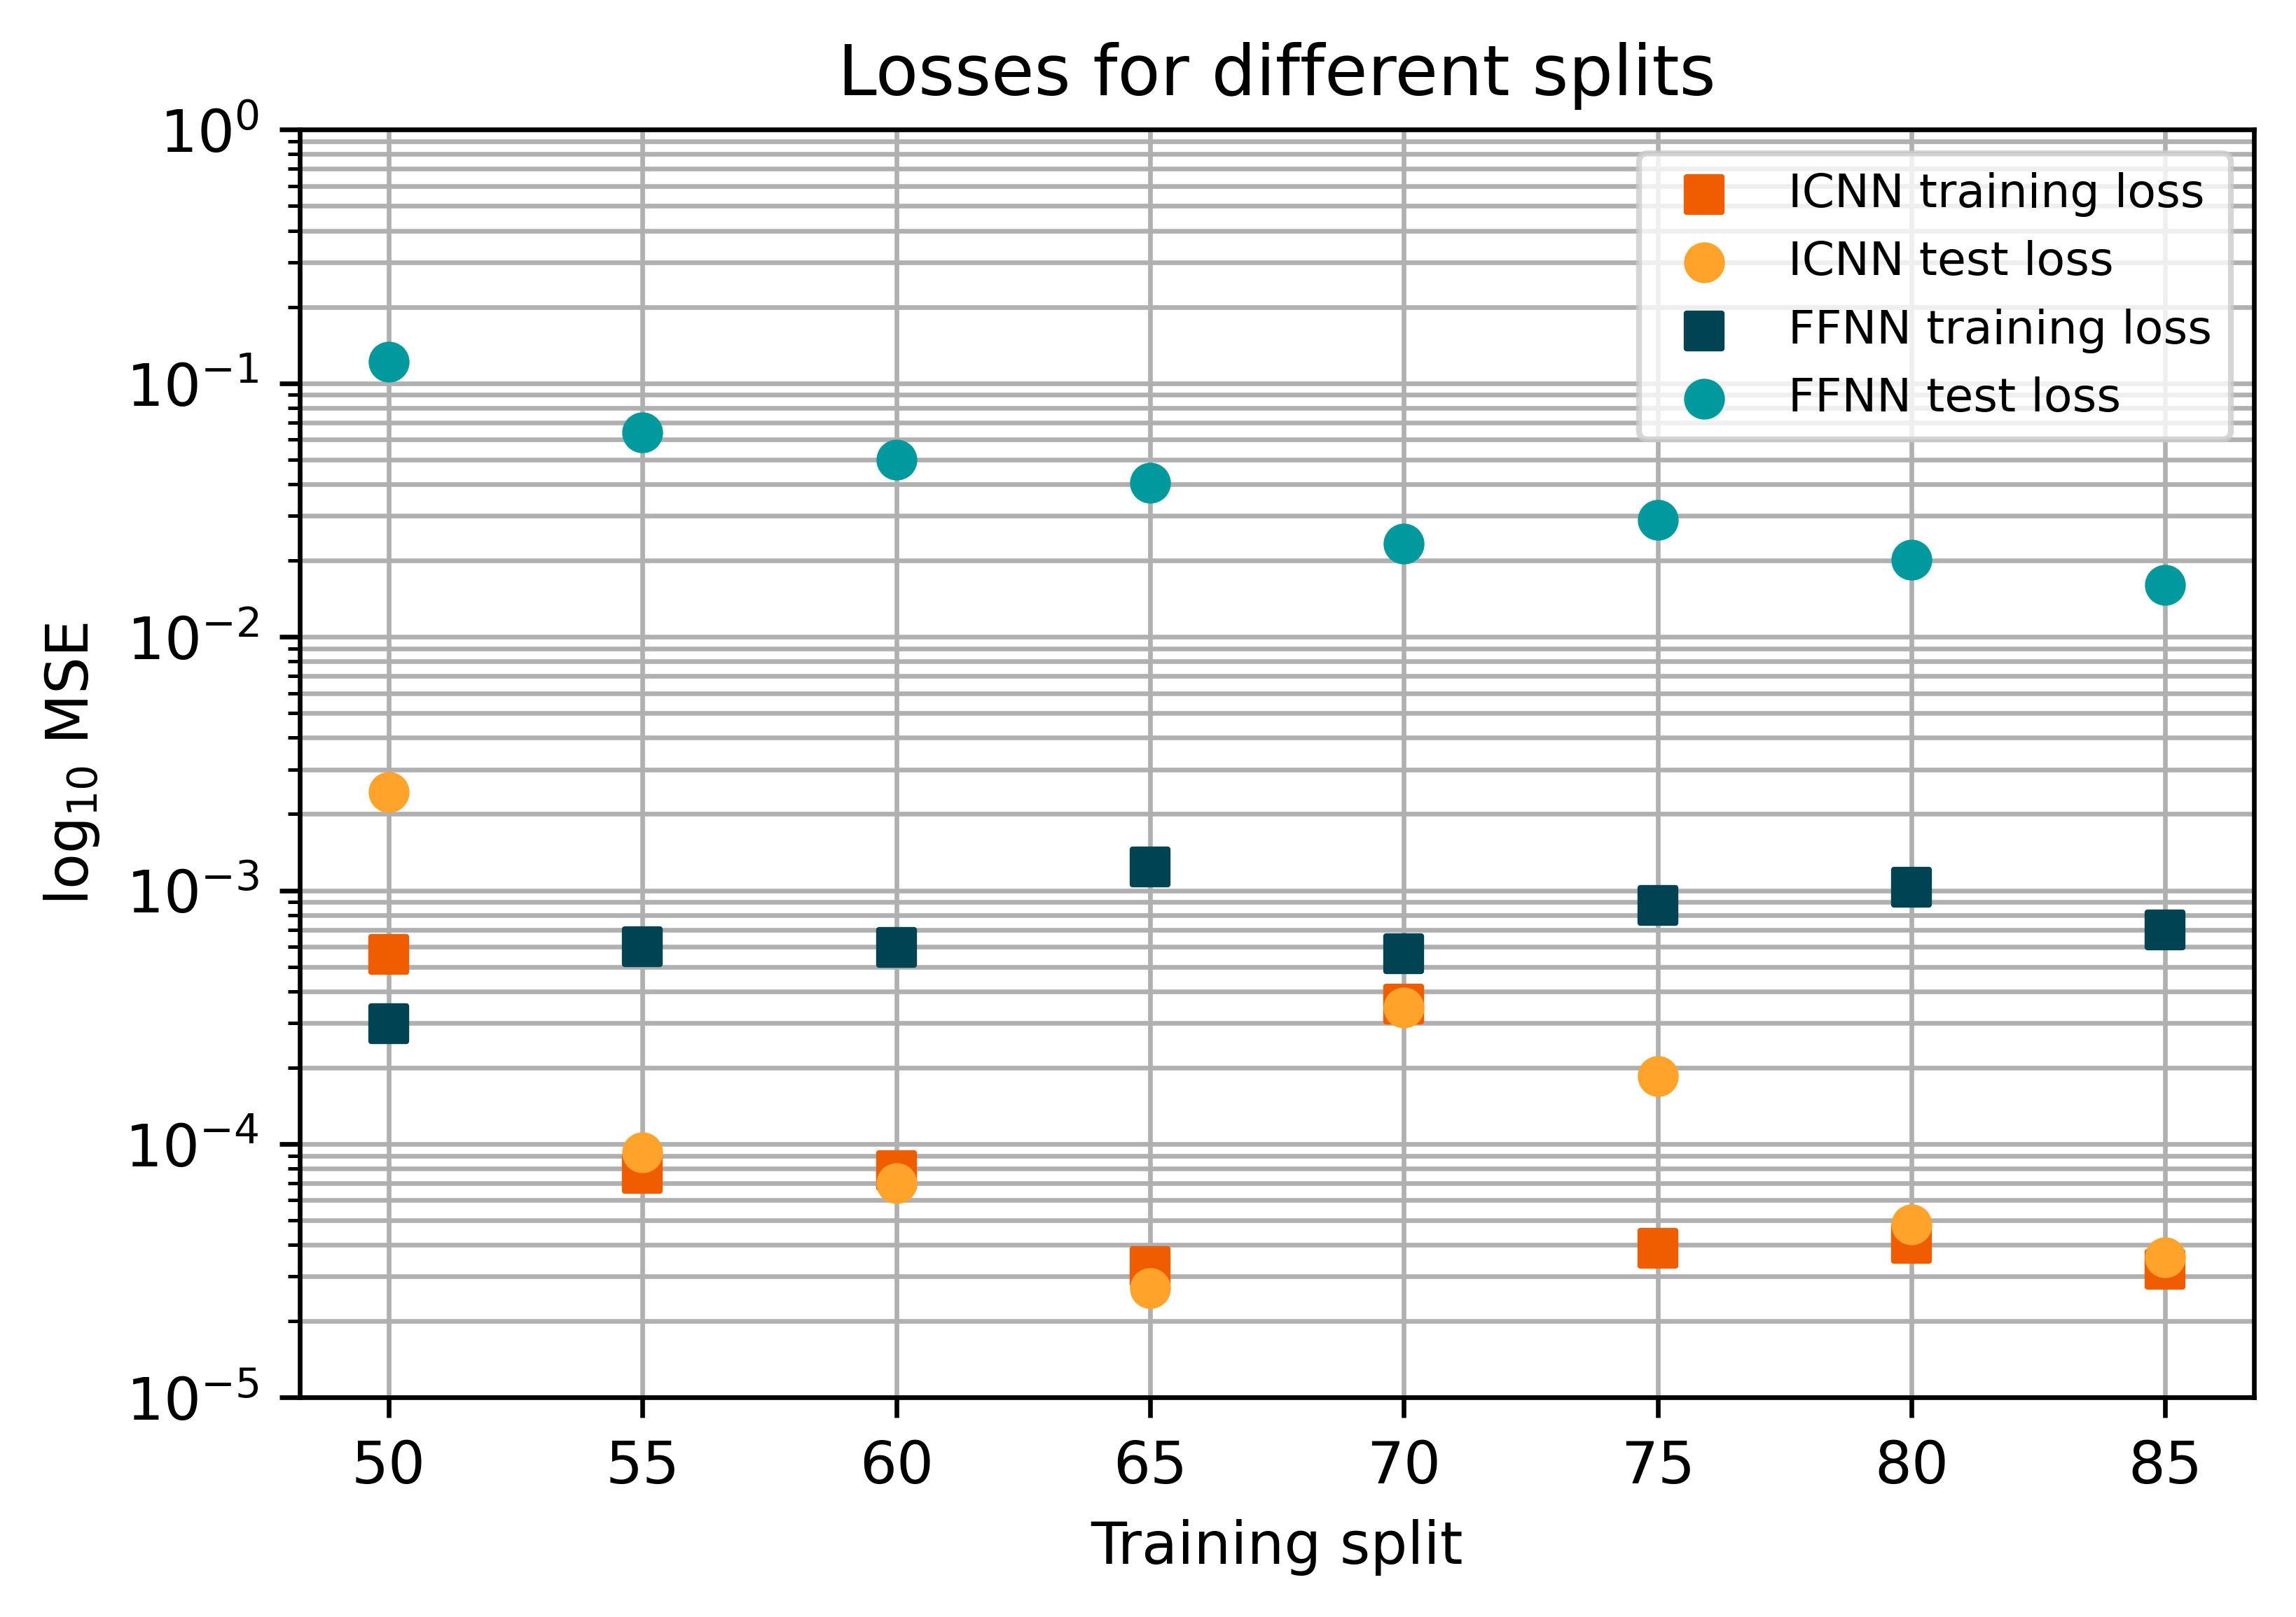
2 – 4
Concentric sampled deformation gradients
ICNN: Layers: 8, 8, 1 Epochs: 300 Learn rate: 0.002 Batch size: 32
FFNN: Layers: 32, 32, 16, 9 Epochs: 6000 Learning rate: 0.002 Batch size: 512
Notes:
Talk about inductive Bias and differences in architecture & generalization behaviour

Slide 30
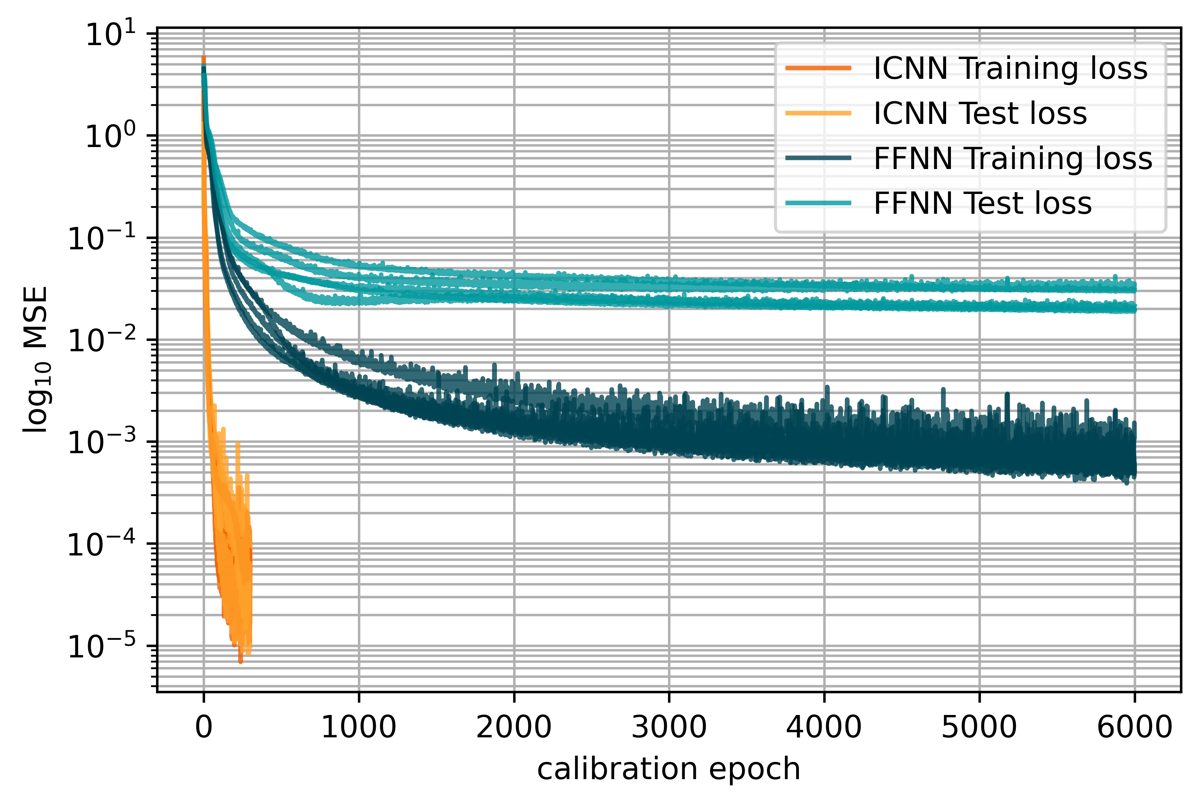
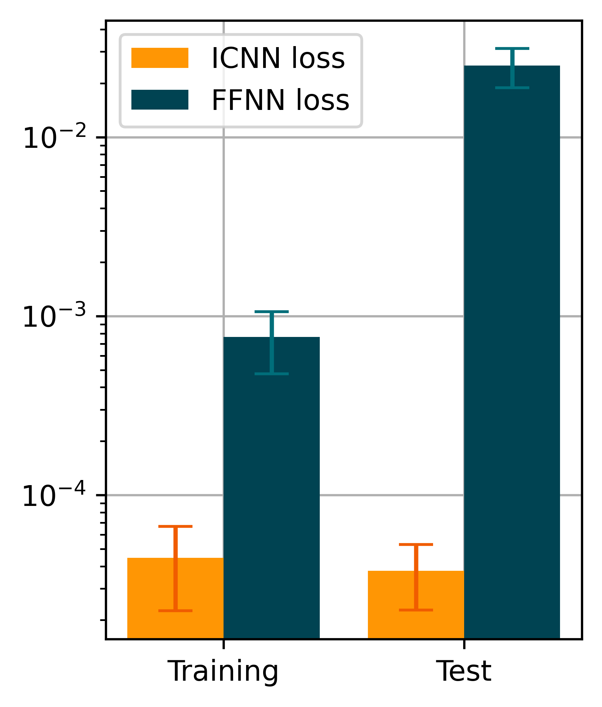
2 – 4
Concentric sampled deformation gradients
ICNN: Layers: 8, 8, 1 Epochs: 300 Learn rate: 0.002 Batch size: 32
FFNN: Layers: 32, 32, 16, 9 Epochs: 6000 Learning rate: 0.002 Batch size: 512
80/20
Split
Notes:
Talk about inductive Bias and differences in architecture & generalization behaviour

Slide 31
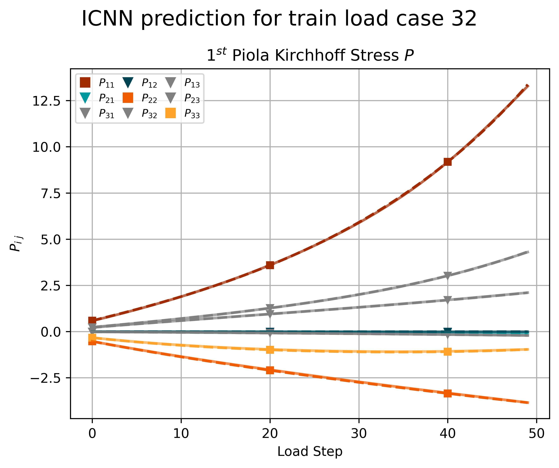
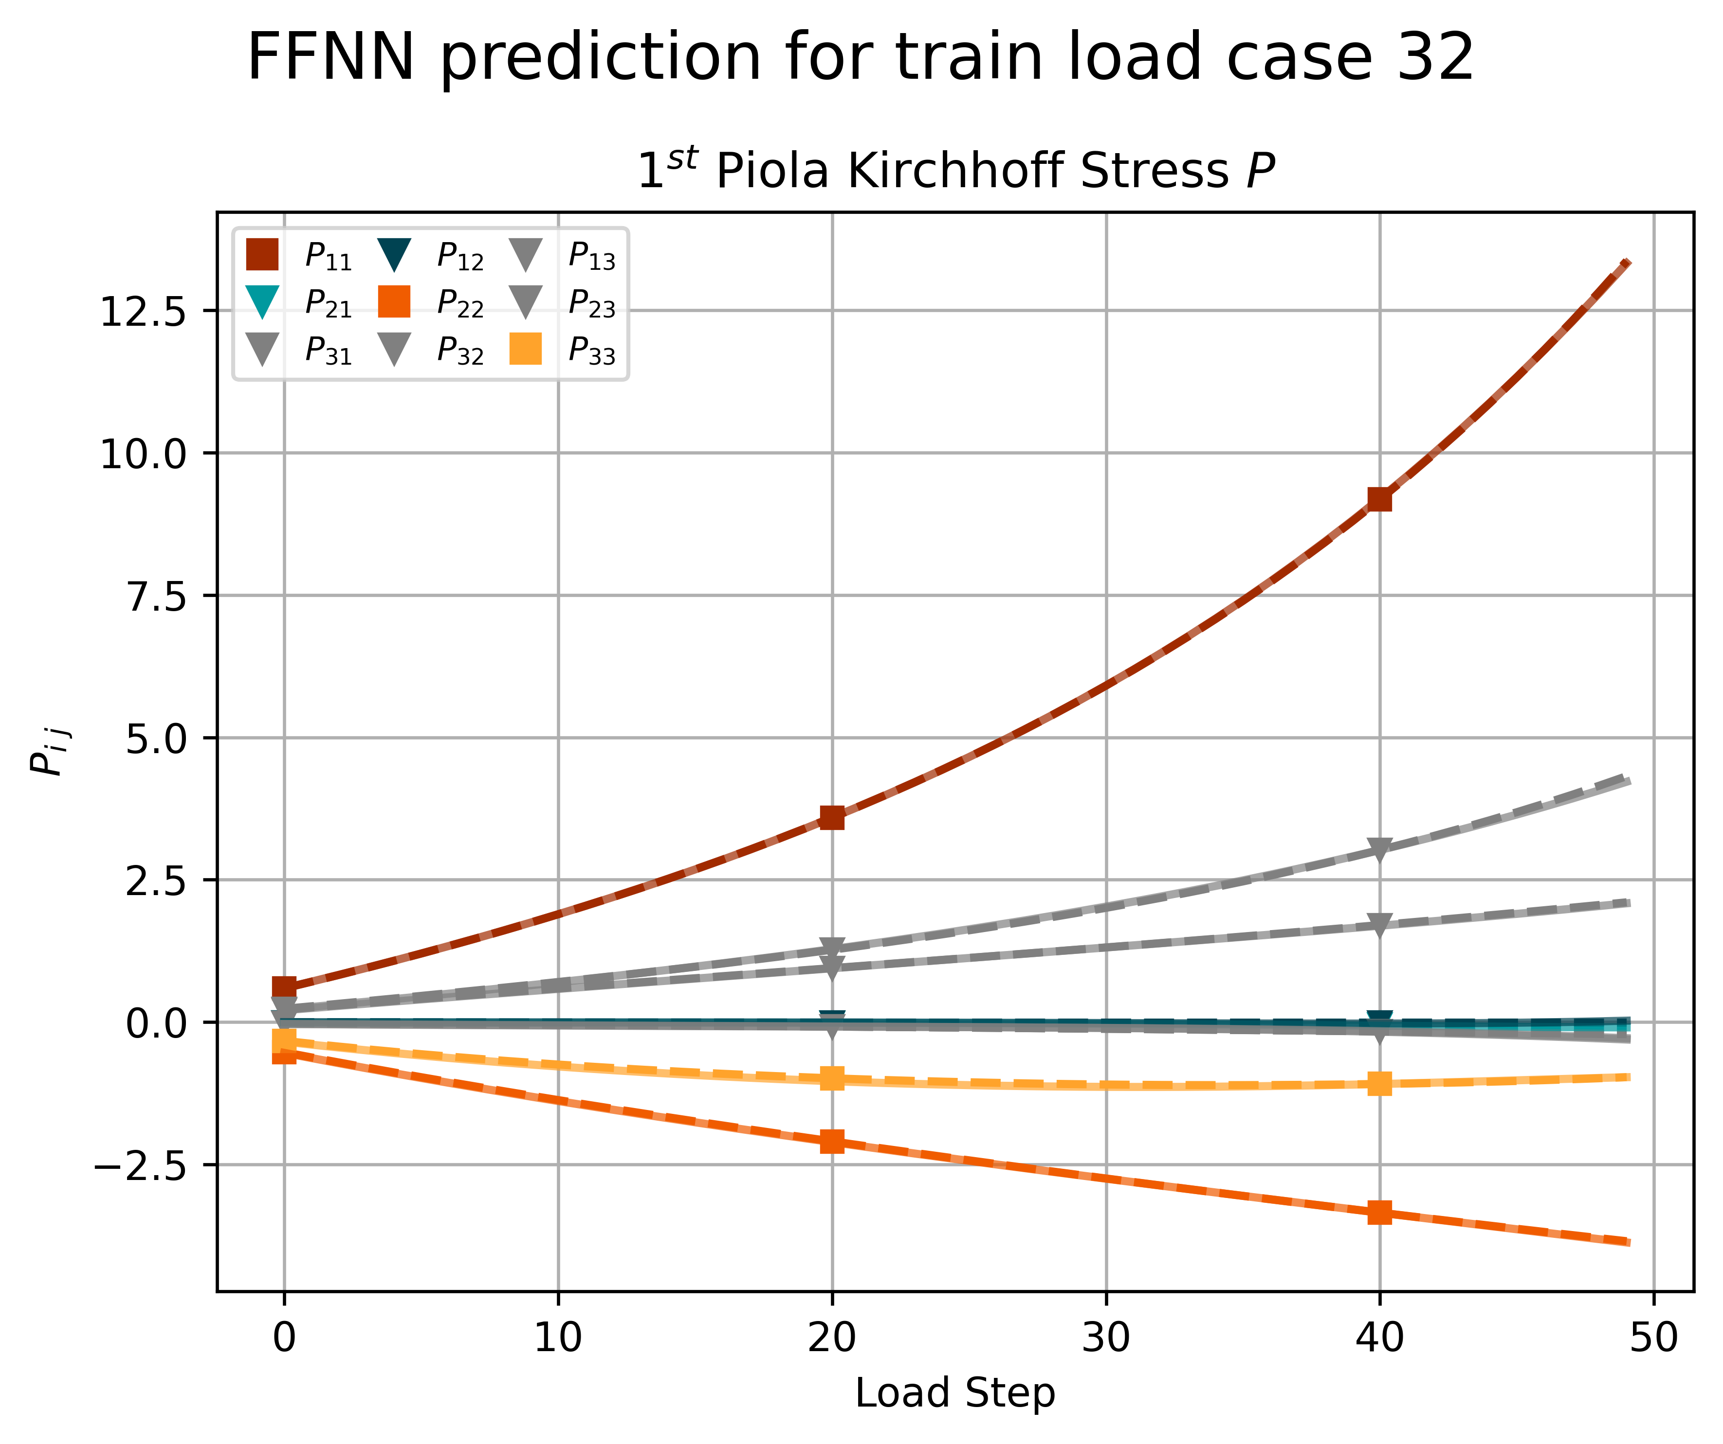
2 – 4
Training Load Case
ICNN
FFNN
80/20
Split

Slide 32
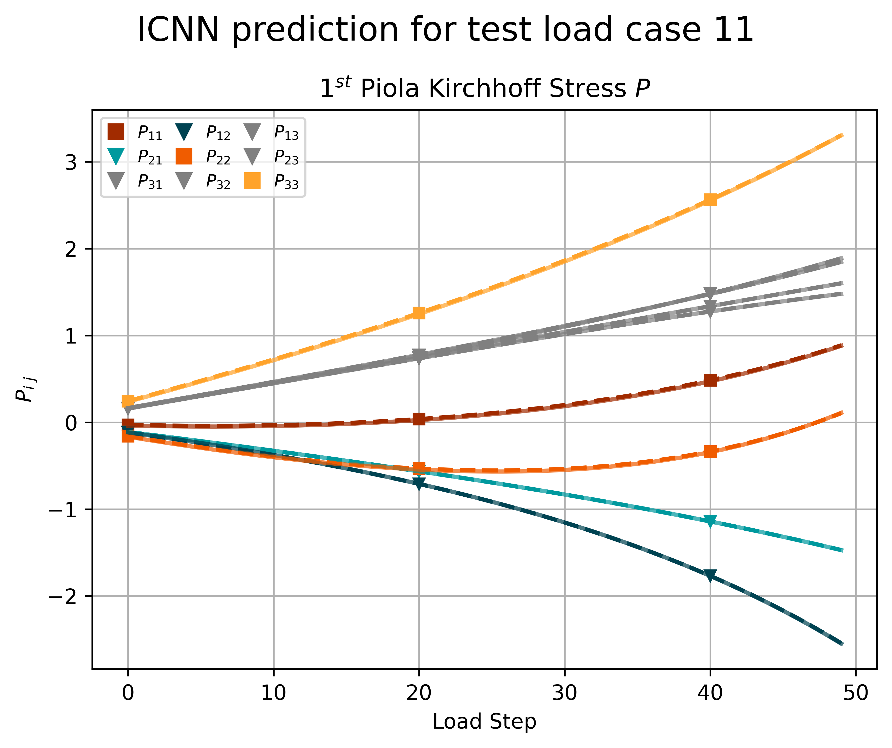
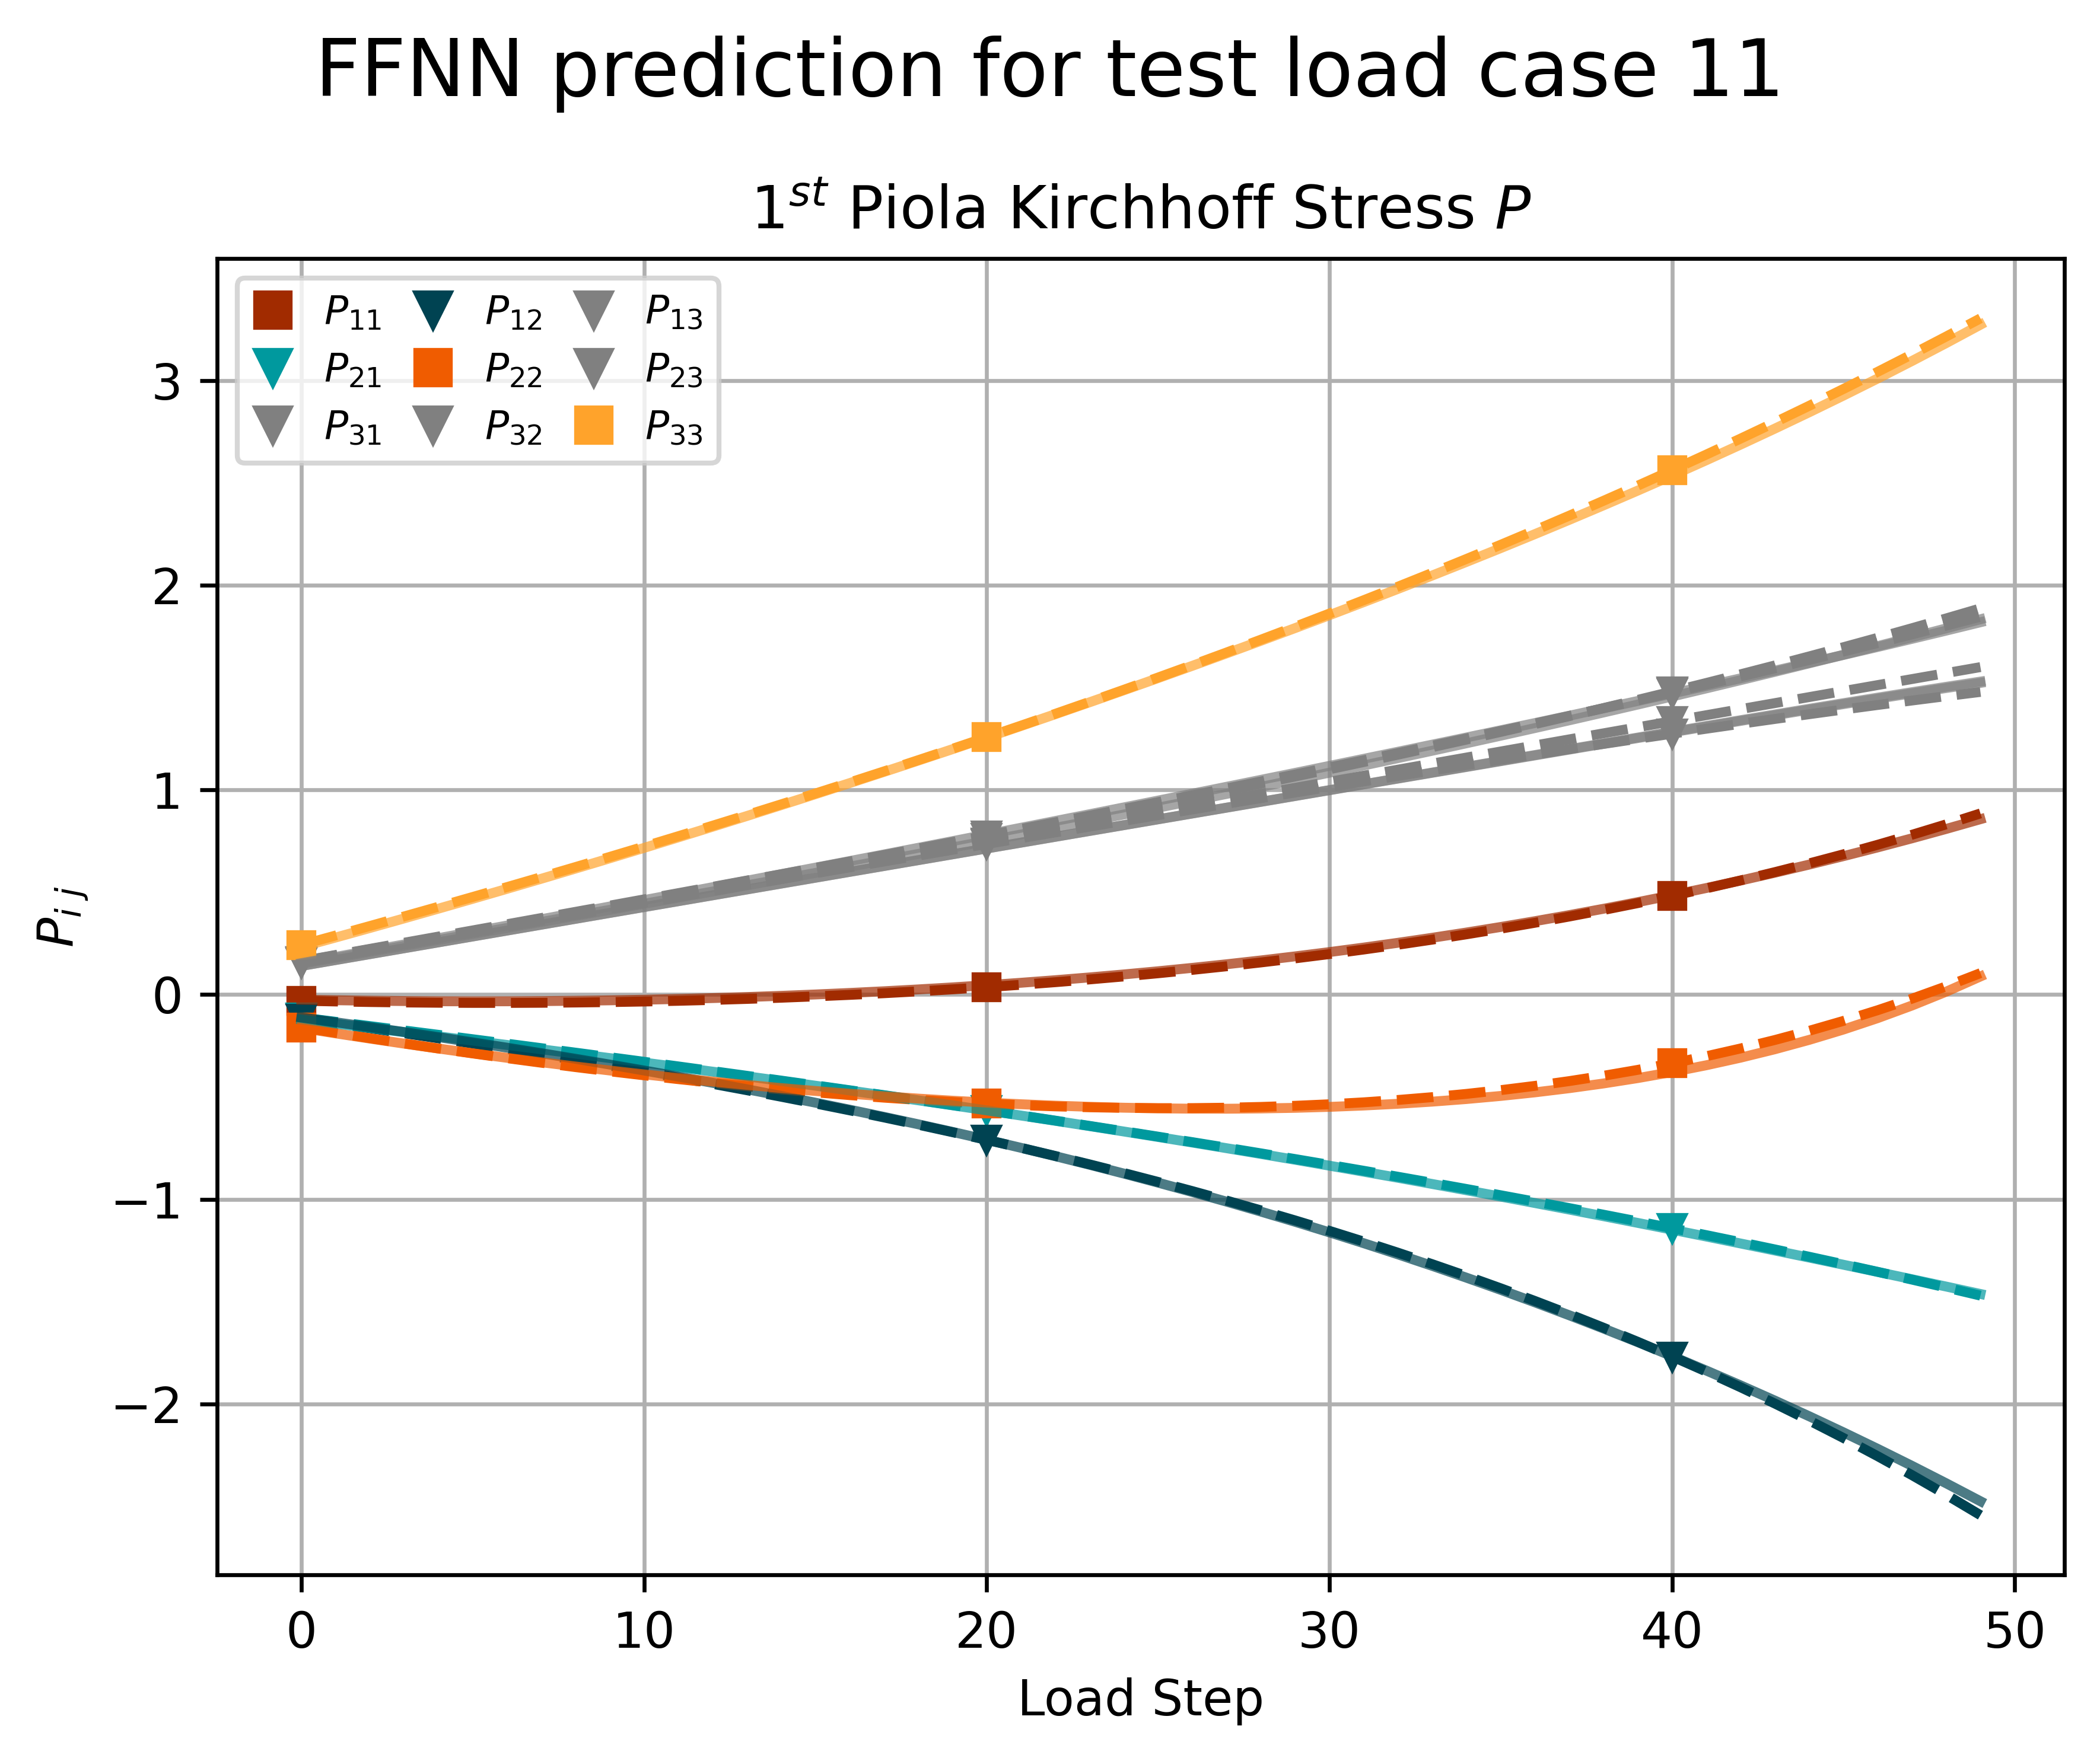
2 – 4
Test Load Case
ICNN
FFNN
80/20
Split

Slide 33
Task 3
Hyperelasticity II

Slide 34
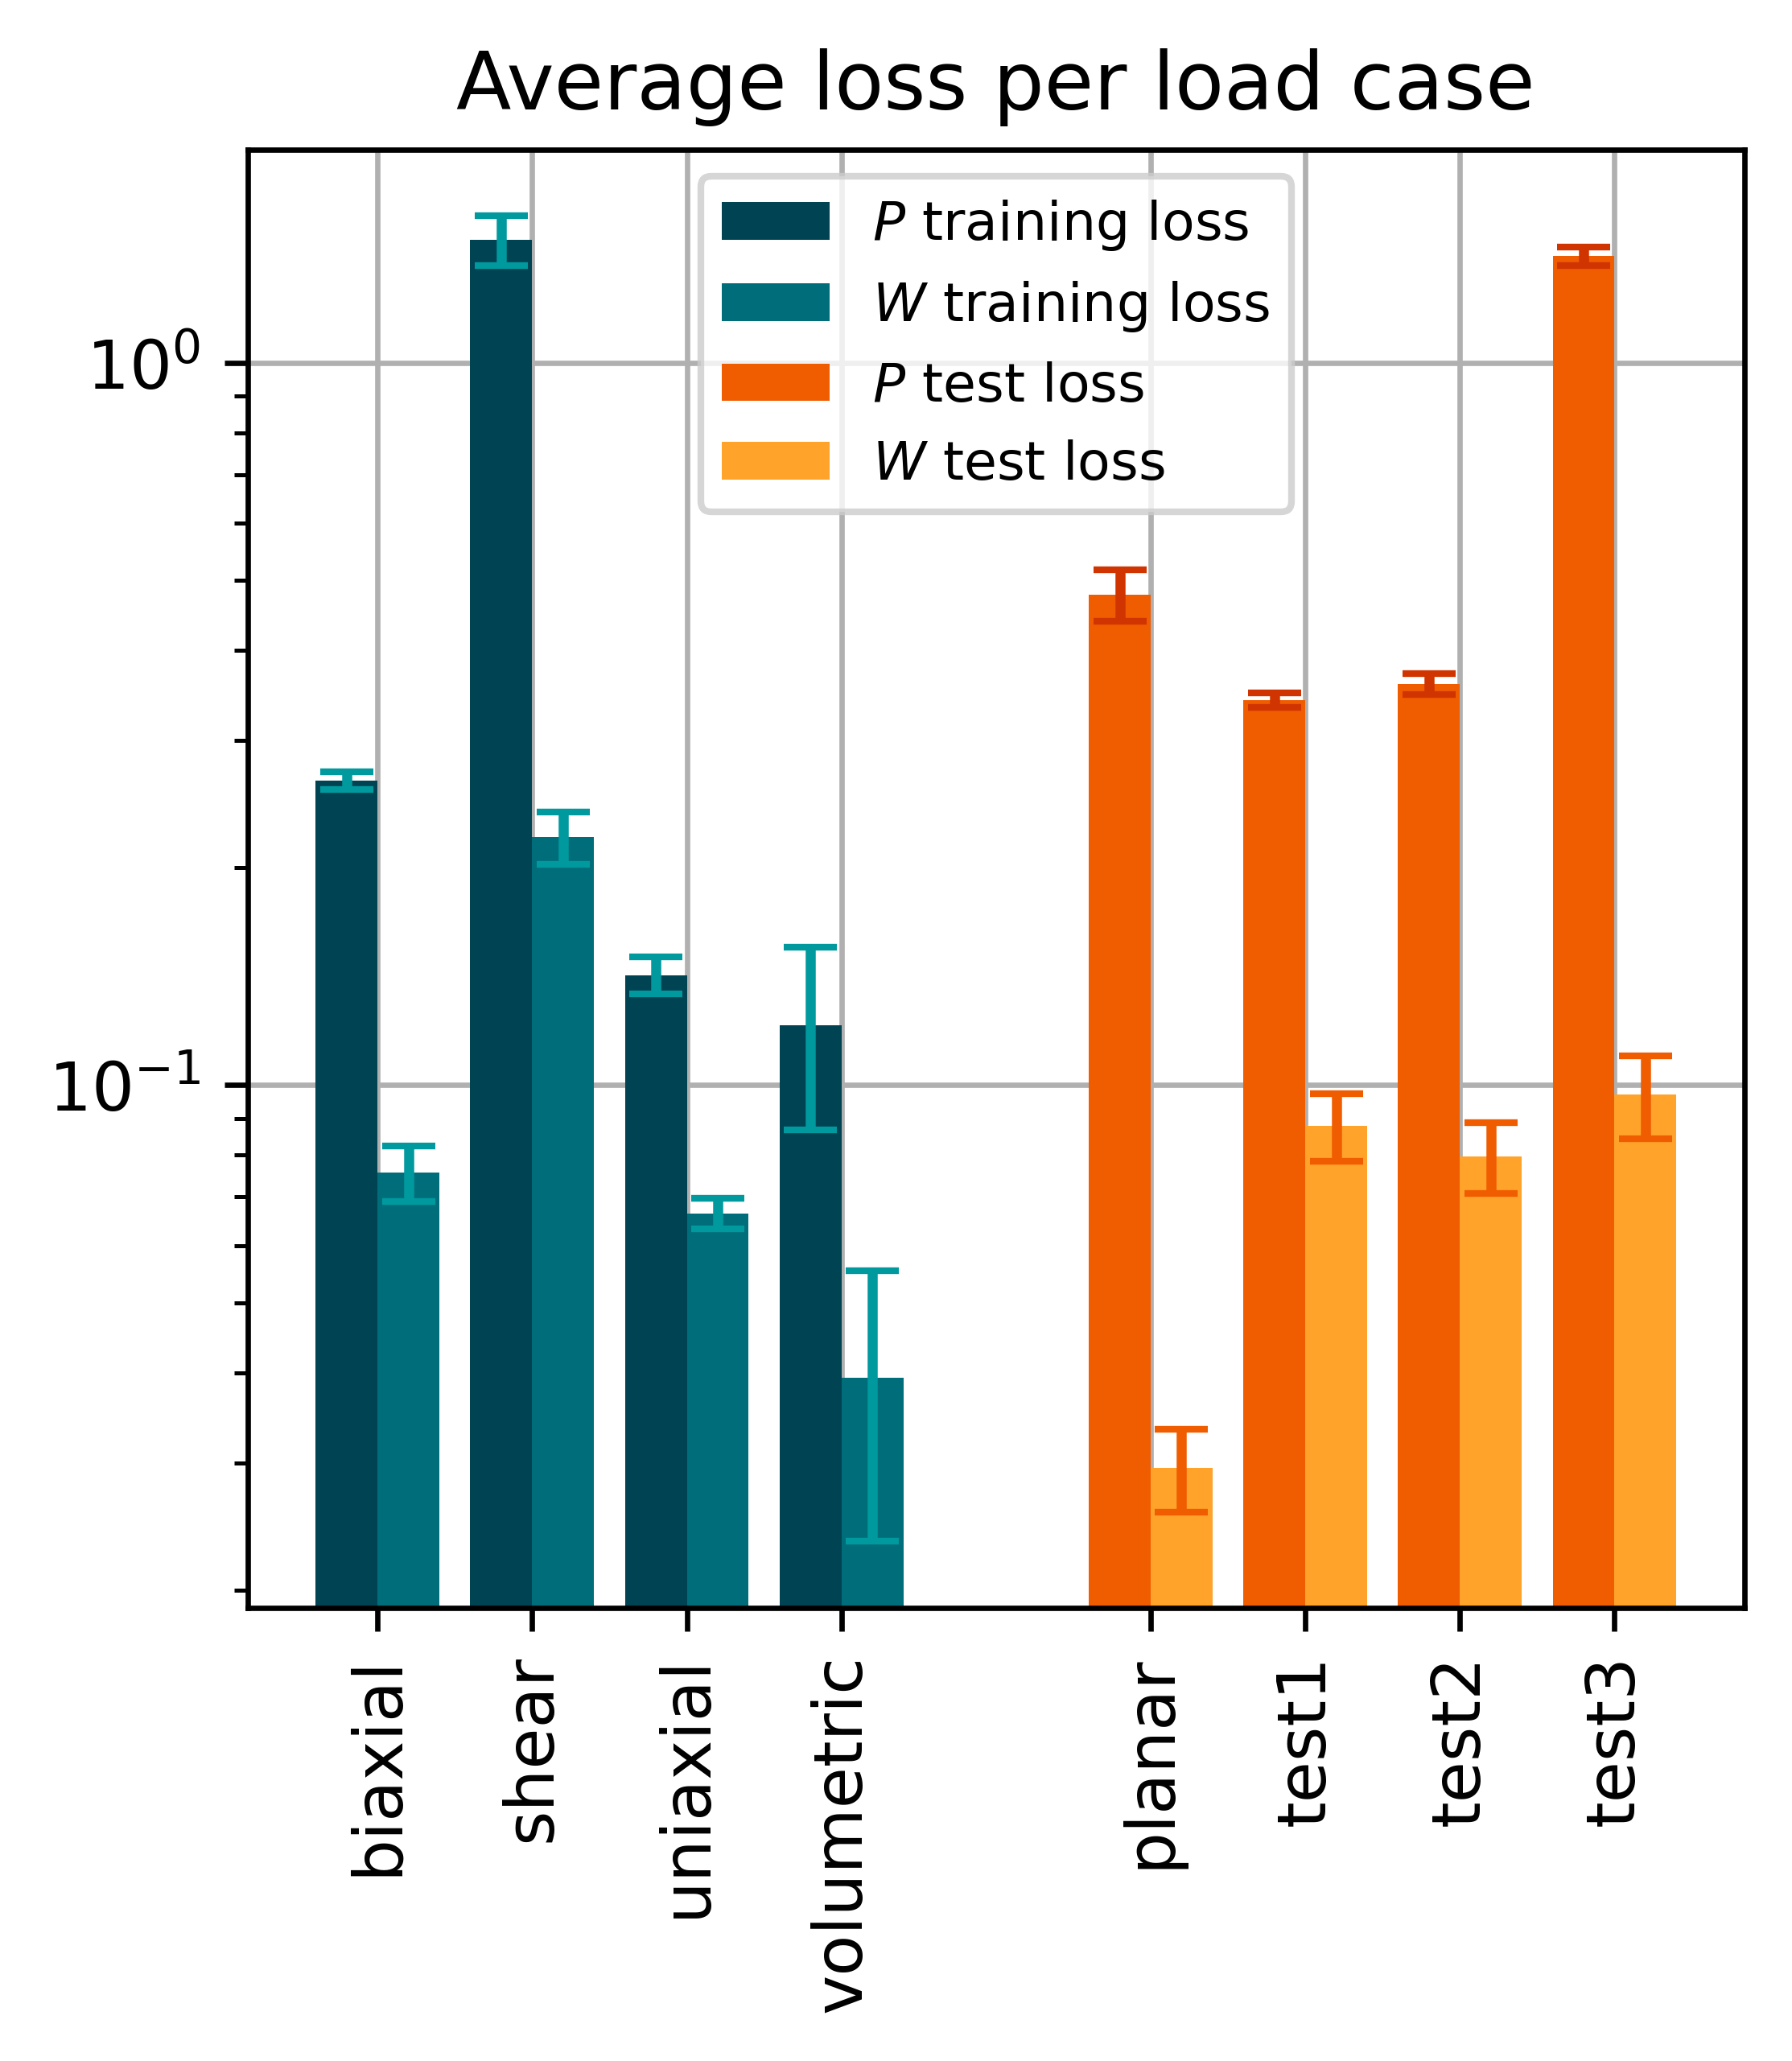
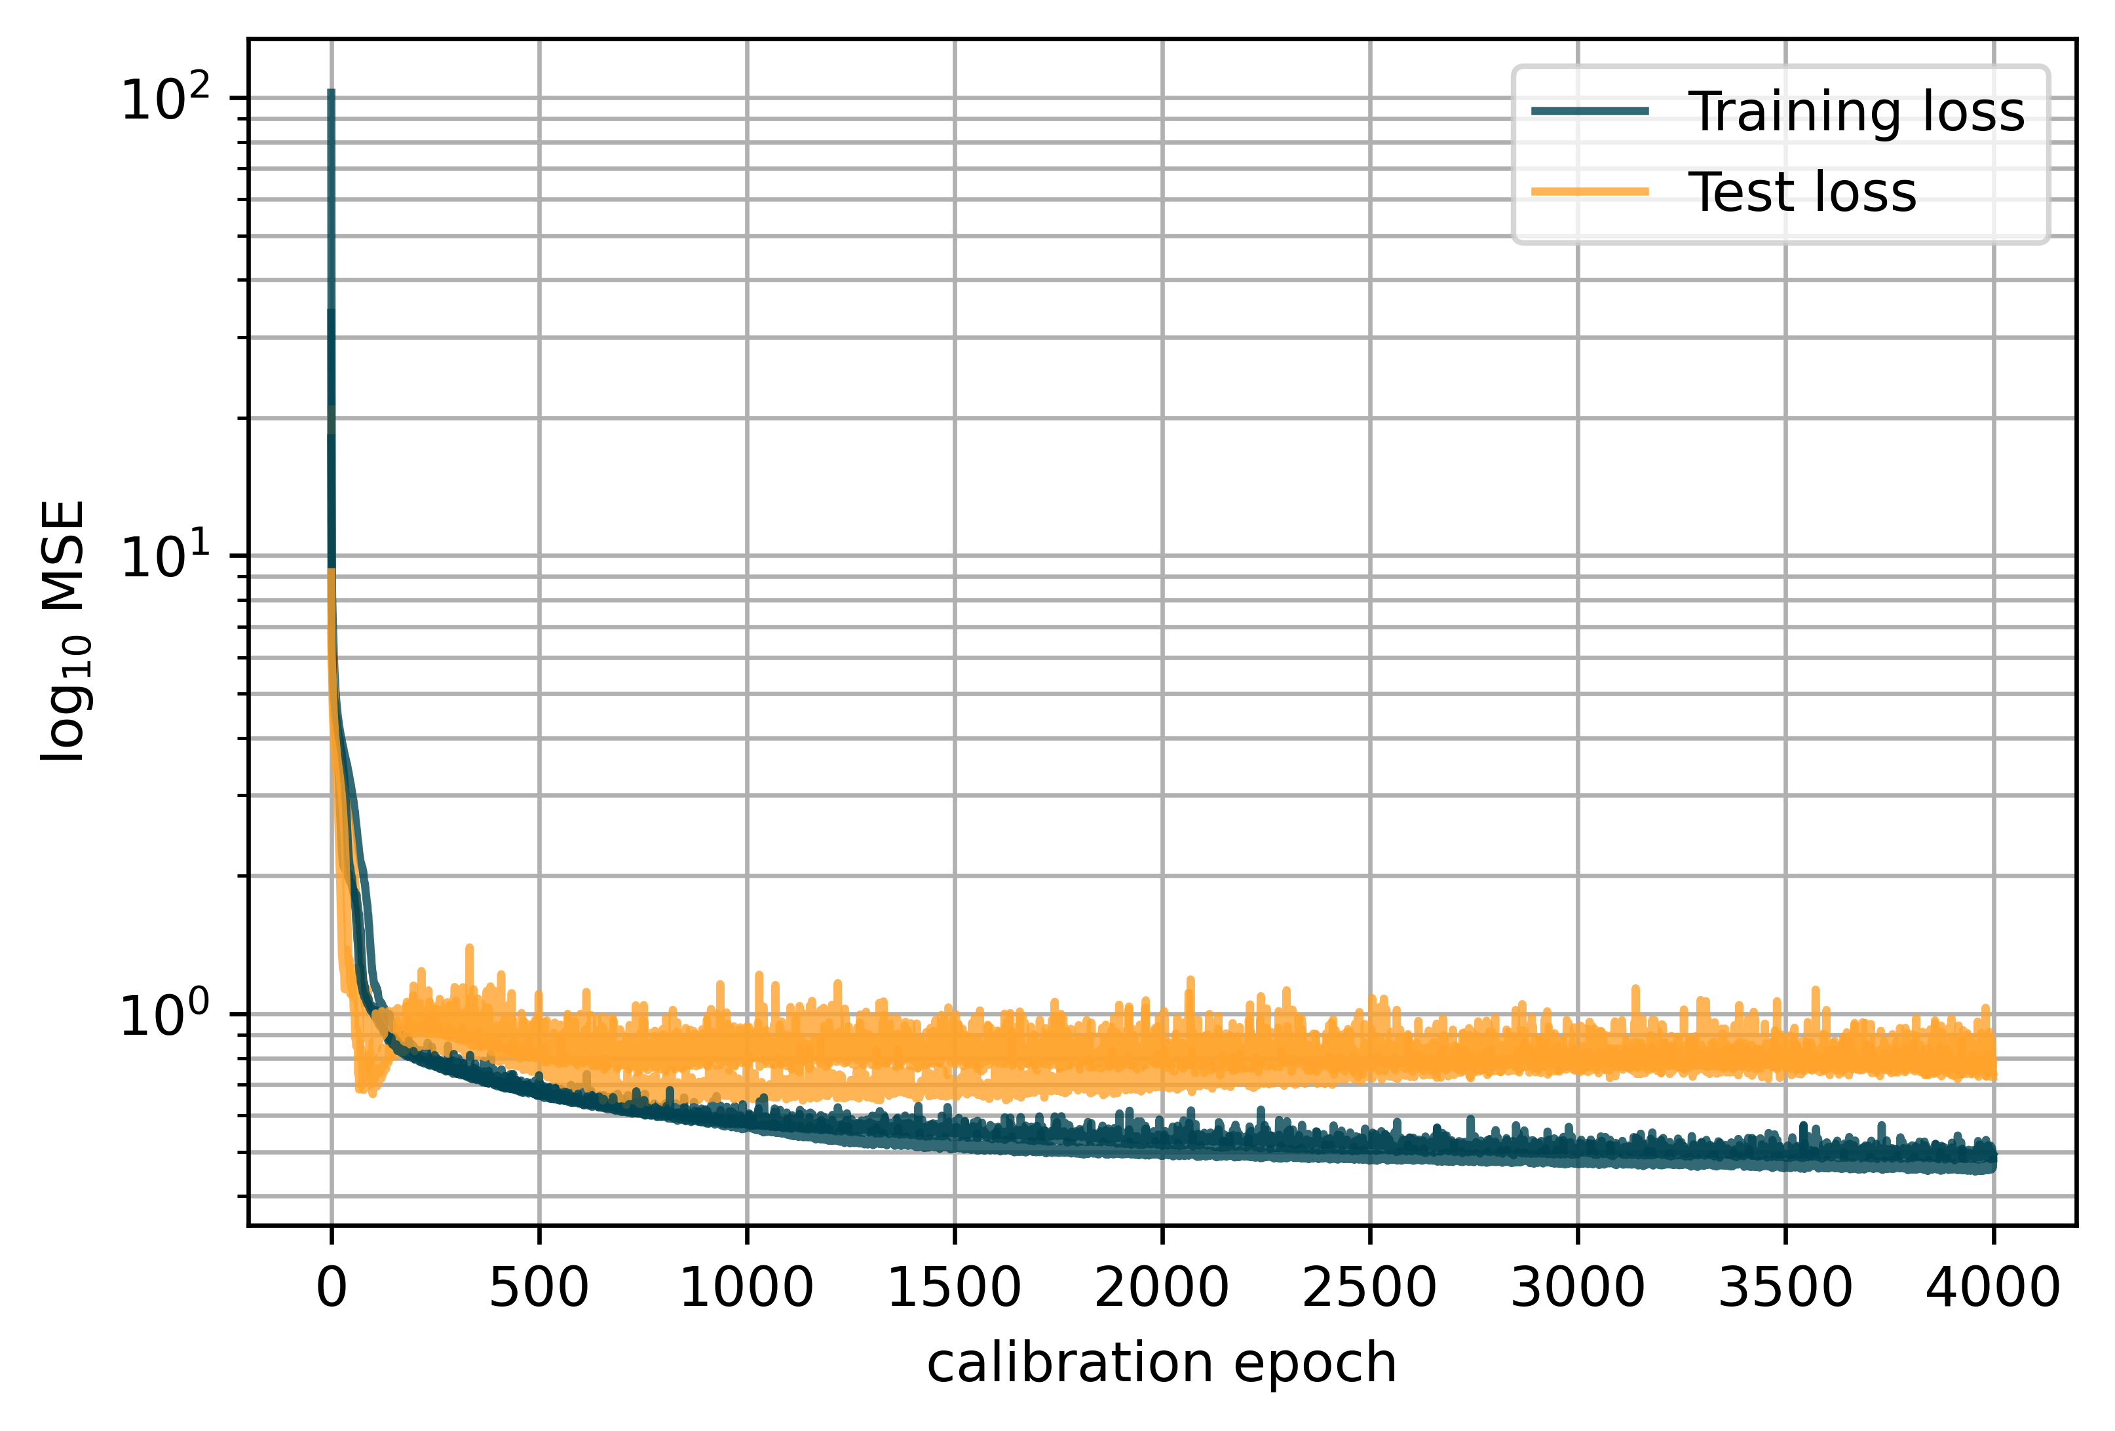
3 – 1.2
Invariant-based model
3 Instances
Layers: 16, 16, 1 Epochs: 4000 Learn rate: 0.005
Notes:
Maybe add weights as a diagram

Slide 35
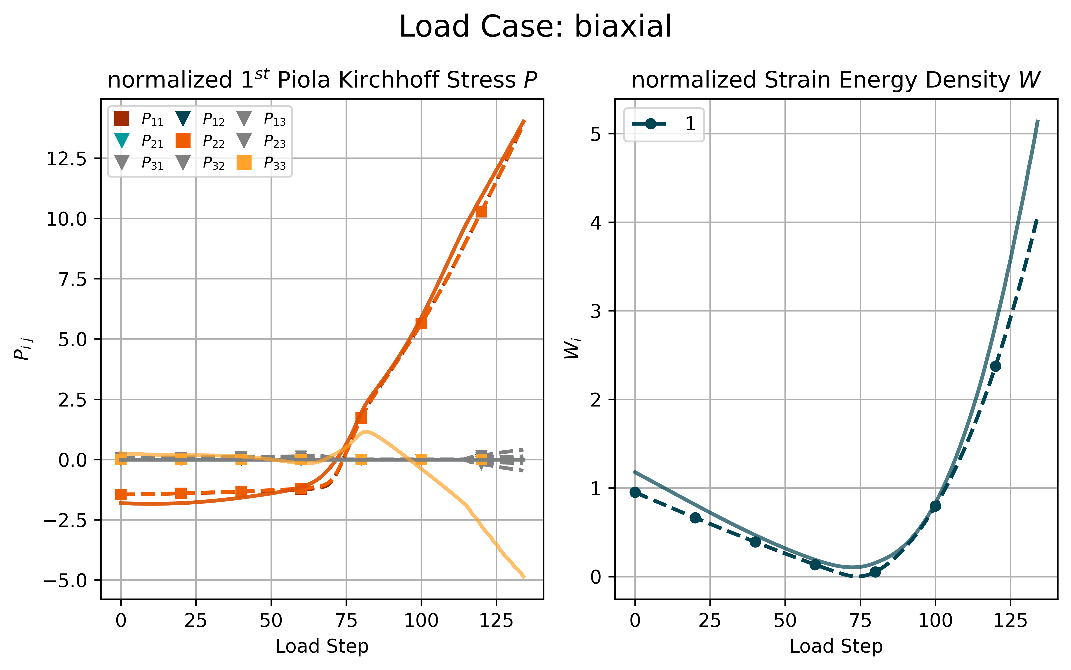
3 – 1.2
Invariant-based model
Notes:
Maybe add weights as a diagram

Slide 36

3 – 1.2
Invariant-based model
Notes:
Maybe add weights as a diagram

Slide 37

3 – 1.2
Invariant-based model
Possible reasons for bad fit:
To little information in Invariants
Model not flexible enough
Notes:
Maybe add weights as a diagram

Slide 38

3 – 2
Deformation-gradient based model (DGBM)
Physical conditions:
Objectivity
Material Symmetry
Thermodynamics
Polyconvexity/Ellipticity
Normalization
Growth Condition
Notes:
Why –J, why restriction on first layer of ICNN

Slide 39


3 – 2
Deformation-gradient based model (DGBM)
3 Instances
Layers: 16, 16, 1 Epochs: 6000 Learn rate: 0.005

Slide 40

3 – 2
DGBM - Problems
Notes:
Worst performing model

Slide 41

3 – 2
DGBM - Problems
Notes:
Best performing model

Slide 42

3 – 2
Deformation-gradient based model

Slide 43



3 – 2
DGBM – Material Symmetry

Slide 44



3 – 2
DGBM – Objectivity

Slide 45


3 – 2
Deformation-gradient based model

Slide 46


3 – 2
DGBM, IBM Comparison
DGMB: Layers: 16, 16, 1 Epochs: 8000 Learn rate: 0.01
IBM: Layers: 32, 32, 16, 1 Epochs: 4000 Learning rate: 0.01

Slide 47


3 – 3
Data augmentation
Layers: 32, 32, 32, 1 Epochs: 300, 750 Learn rate: 0.01, 0.005
Batch size: 512, 1024 Observer: 64 Cubic group: All 24
64
Observer

Slide 48

3 – 3
Data augmentation

Slide 49

3 – 3
Data augmentation

Slide 50



3 – 3
Data augmentation
Objectivity
Model trained on shear case only
1000 Evaluation Observers

Slide 51
Tutorial Machine Learning in Solid Mechanics
Discussion

Slide 52


2 – 4
Concentric sampled deformation gradients
ICNN: Layers: 8, 8, 1 Epochs: 300 Learn rate: 0.002
FFNN: Layers: 32, 32, 16, 9 Epochs: 6000 Learning rate: 0.002 Batch size: 512
95/5
Split
Notes:
Talk about inductive Bias and differences in architecture & generalization behaviour

Slide 53


2 – 4
Training Load Case
ICNN
FFNN
95/5
Split

Slide 54


2 – 4
Test Load Case
ICNN
FFNN
95/5
Split

Slide 55

3 – 3
Data augmentation

Slide 56


3 – 3
Data augmentation
Objectivity

Slide 57


3 – 3
Data augmentation
Objectivity

